Slide 1
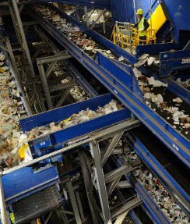
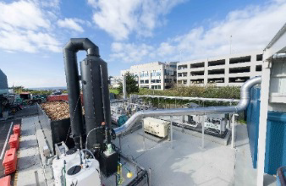
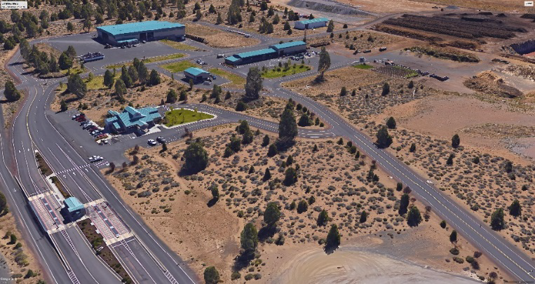
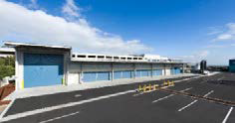

Slide 2
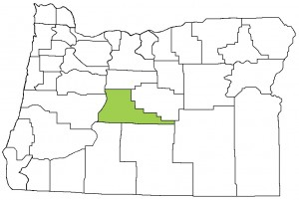
SWMP Planning Process
Agenda
Introductions - Project Team
Overview of Department of Solid Waste Operations
SWAC Participation
Site Tour
Chapter 1 – Introduction to SWMP
Chapter 2 – Existing Conditions
Questions/Comments/Issues
Next meeting

Slide 3
JRMA Team
J.R. Miller & Associates
Gershman,
Brickner &
Bratton, Inc.
ESI
G. Friesen, Associates
Barney & Worth
Over 100 years in Solid Waste Industry combined
Brings together specialists from all aspects of Integrated Waste Management planning, procurement, design, construction & operations
Proven track record Nationally, in Oregon, and in Deschutes County
Prepared over 200+ SWMP’s
“Creating a Roadmap for a Sustainable Future”

Slide 4
Introduction
“Creating a Roadmap for a Sustainable Future”

Slide 5
Solid Waste Advisory Committee
(SWAC)
SWAC Assignment
Provide input on how Deschutes County processes solid waste after Knott Landfill reaches capacity.
Evaluate the economic and environmental impacts of disposal options.
Examine other aspects of the solid waste system: collection, recycling and transfer.
Expectations
Attend regular monthly meetings (Jan - Fall 2018)
Read information provided / ask questions when clarification is needed.
Offer views / recommendations based an understanding of the information presented.
Work toward consensus (but dissenting opinions will be documented)
If contacted by the media, please speak as an individual—not for the SWAC.
All discussions regarding recommendations will be conducted at publicly noticed meetings.
Beware—avoid—declare—conflicts of interest.

Slide 6
Public Process
SWAC meetings open to the public
Announcements and updates on County website
Timely mailings to interested parties
Two public workshops / meetings

Slide 7
Chapter 1 - Introduction
Plan Purpose and Goals
Key Objectives and Evaluating Factors
Legal Requirements
Plan Organization

Slide 8
Purpose of SWMP
Primary Goal of SWMP
“To work cooperatively with Cities and service providers to offer citizens and businesses an integrated solid waste management system that delivers quality and cost-effective services while achieving the best use of our resources and reducing waste disposed in landfills.”

Slide 9
Key Objectives & Evaluating Factors
1. To provide an integrated solid waste management system that addresses an effective combination of strategies and programs guided by the hierarchy adopted by the state.
2. To continue educating consumers in order to promote practices and methods to reduce the long-term per capita waste generation rate.
3. To develop programs and support implementation of system improvements that seek to ensure materials recovered from the waste stream attain the highest and best use and are recycled.
4. To develop a solid waste system that is based on sound financial principles, provides cost effective services and maintains rate stability over a long term, while allocating costs equitably to all users.
5. To maintain system flexibility to respond to changes in waste stream composition, waste management technologies, public preferences, new laws and changing circumstances.

Slide 10
Key Issues
Current recovery rate is 33%. New goal is 45% by 2025.
Address impacts based off the current collection services, considering the growth in population.
Consider strategies to extend the site life of Knott Landfill?

Slide 11
Key Issues (Cont.)
Are there proven and reliable technologies that would reduce the County’s dependency on landfill disposal?
What is the best approach for providing for reliable and cost effective long-term disposal capacity?
What investments/ improvements are needed at the County’s transfer station to address the long-term system needs and to provide convenient cost-effective services?

Slide 12
Key Issues (Cont.)
What is the best approach to optimize the extraction and utilization of landfill gas generated at the Knott Landfill.?
What is the best approach for funding the capital improvements required to meet the future solid waste system needs?
Consider regional approaches to provide cost effective services that benefit the greater central Oregon region.
What is the timeline/ schedule when critical investments in the solid waste system.

Slide 13
Regulatory Authority
Under ORS 459 – Cities and Counties have similar requirements to ensure basic services for collection. Recycling and disposal services are provided to all residences and businesses.
Predominant method of providing collection is through franchises or licensing.
Disposal sites are either owned by public or contracted with private.
State supports local government coordination (ORS 459.065)
Prepare SWMP’s
Joint Implementation of facilities
Related to new landfill (ORS 459.017)
A local government prepares SWMP that identifies need for a landfill
State will work local government to site permit and implement a new landfill disposal site.

Slide 14
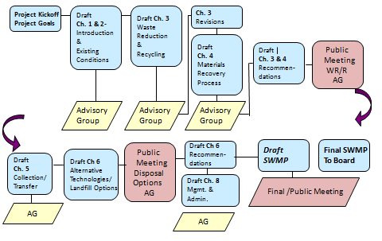
Plan Organization

Slide 15
Chapter 2 - Background
Introduction
Characteristics of the Planning Area
Transfer Stations
Historical Data

Slide 16
Chapter 2 - Background
Jurisdiction | Population
Bend | 83,500
Redmond | 27,595
La Pine | 1,675
Sisters | 2,390
Un-incorporated Cities | 66,147
Total | 181,307

Slide 17
Summary of Annual Solid Waste Generation
Solid Waste Tons Per Year
Total Solid Waste | 2010 | 2011 | 2012 | 2013 | 2014 | 2015 | 2016
Generated | 177,107 | 185,386 | 185,676 | 193,744 | 203,921 | 227,333 | 240,844
Disposed | 115,030 | 112,751 | 113,611 | 119,682 | 130,956 | 143,952 | 161,087
Recovered | 62,077 | 72,635 | 72,065 | 74,062 | 72,965 | 83,381 | 79,757

Slide 18
Summary of Annual Solid Waste Generation
Solid Waste Tons Per Year

Slide 19
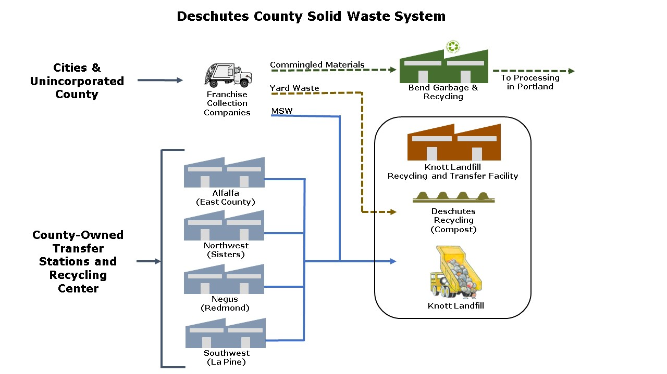
Chapter 2 – Solid Waste System

Slide 20
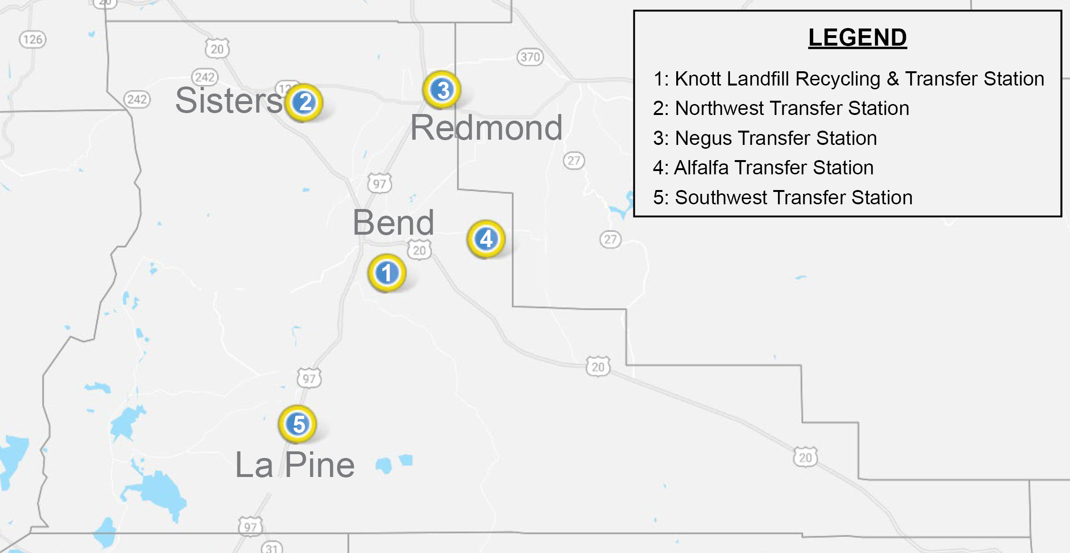
Transfer Stations
Transfer Station Locations

Slide 21
Transfer Stations
Remote Transfer Station Tonnages
Transfer Station | 2012 Tons | 2013 Tons | 2014 Tons | 2015 Tons | 2016 Tons | 2017 Tons
Negus | 21,825 | 23,510 | 25,444 | 28,502 | 31,309 | 34,948
Northwest | 3,166 | 2,965 | 3,037 | 3,429 | 3,738 | 3,630
Southwest | 6,491 | 7,074 | 7,386 | 8,203 | 9,193 | 9,788
Alfalfa | 155 | 157 | 151 | 165 | 170 | 184
Subtotal Remote Transfer Station | 31,637 | 33,706 | 36,018 | 40,299 | 44,410 | 48,550
Knott Landfill | 22,838 | 25,349 | 25,444 | 28,501 | 31,509 | 45,020
Total Transfer | 54,475 | 59,055 | 61,462 | 68,800 | 75,919 | 93,570

Slide 22
Transfer Stations
Yearly Transfer Station Tonnages

Slide 23
Transfer Stations – Knott Landfill
Deschutes County Tonnages to Disposal Operations
Knott Landfill | 2010 | 2011 | 2012 | 2013 | 2014 | 2015 | 2016 | 2017*
Annual Waste Disposed | 114,307 | 110,528 | 112,859 | 119,269 | 130,615 | 144,981 | 161,081 | 181,320
% Change |  | (3.3%) | 2.1% | 5.7% | 9.5% | 11.0% | 11.1% | 11.4%

Slide 24
Recycling at Transfer Stations
Annual Recycling Materials Recycled at Transfer Stations 2016
 | Alfalfa | Knott | Negus | Northwest | Southwest | Total
Appliances |  |  | 166 | 27 | 74 | 267
Batteries |  |  | 7 | 2 | 4 | 14
Cardboard |  |  | 114 | 24 | 63 | 201
Commingled | 20 |  | 122 | 37 | 94 | 273
Electronics |  |  | 100 |  |  | 100
Glass | 8 |  | 78 | 27 | 45 | 158
Hazardous Waste |  | 264 |  |  |  | 264
Motor Oil |  |  | 23 | 2 | 11 | 37
Scrap Metal | 9 | 4 | 230 | 71 | 138 | 451
Trans/Propane |  | 0.84 |  |  |  | 0.84
Tires | 0.06 |  | 43 | 4 | 14 | 61.06
Totals | 37 | 269 | 883 | 193 | 443 | 1,826

Slide 25
Recycling at Transfer Stations
Yearly Recycling Rates Wood/ Yard Waste

Slide 26
Collection of Commingled Recyclables
Recycling Center | 2014 | 2015 | 2016
Bend Garbage & Recycling | 4,289 | 4,480 | 4,753
Cascade Disposal | 4,450 | 4,658 | 4,805
High Country Disposal | 3,225 | 3,318 | 3,409
Wilderness Garbage and Recycling | 54 | 58 | 50
Total | 12,018 | 12,514 | 13,017

Slide 27
Historical Solid Waste Data
Summary of Historic Waste Stream Data for Deschutes County
Waste | 2010 | 2011 | 2012 | 2013 | 2014 | 2015 | 2016
Generated | 177,107 | 185,386 | 185,676 | 193,744 | 203,921 | 227,333 | 240,844
Disposed | 115,030 | 112,751 | 113,611 | 119,682 | 130,956 | 143,952 | 161,087
Recovered | 62,077 | 72,635 | 72,065 | 74,062 | 72,965 | 83,381 | 79,757
Recovery Rate* | 35% | 39.2% | 38.8% | 38.2% | 35.8% | 36.7% | 33.1%

Slide 28
Historical Solid Waste Data
Per Capita Rates
Per Capita | 2010 | 2011 | 2012 | 2013 | 2014 | 2015 | 2016
Generated | 2,243 | 2,334 | 2,319 | 2,384 | 2,451 | 2,663 | 2,727
Disposed | 1,457 | 1,419 | 1,419 | 1,473 | 1,574 | 1,686 | 1,824
Recovered | 786 | 914 | 900 | 911 | 877 | 975 | 903

Slide 29
Deschutes County Waste Stream 2016
Waste Composition | % of Total Waste | Total Waste (Disposed+ Recyclables) (tons) | Waste Disposed (tons) | % Disposed | Recycled Materials (tons)
Total Paper | 26% | 62,198 | 40,272 | 25% | 21,926
Cardboard/ Kraft | 8% | 18,185 | 5,638 | 4% | 12,547
Clean Mixed Paper/ ONP | 7% | 15,822 | 6,443 | 4% | 9,379
Mixed Paper | 5% | 11,276 | 11,276 | 7% | -
Compostable / Soiled | 7% | 16,109 | 16,109 | 10% | -
Total Plastics | 6% | 14,327 | 12,887 | 8% | 1,440
Organics | 43% | 102,654 | 67,657 | 42% | 34,997
Yard Debris | 14% | 33,266 | 6,443 | 4% | 26,823
Wood | 9% | 22,330 | 16,109 | 10% | 6,221
Food | 18% | 42,701 | 41,883 | 26% | 818
Other Organics | 2% | 4,357 | 3,222 | 2% | 1,135
Glass | 4% | 9,786 | 3,222 | 2% | 6,564
Metal | 8% | 19,844 | 11,276 | 7% | 8,568
Aluminum | 1% | 2,230 | 1,611 | 1% | 619
Tin Cans | 1% | 3,549 | 3,222 | 2% | 327
Other (Scrap Metal) | 6% | 14,065 | 6,443 | 4% | 7,622
Other Inorganics | 9% | 21,584 | 19,330 | 12% | 2,254
Rock/ Concrete/ Brick | 3% | 6,033 | 4,833 | 3% | 1,200
Gypsum Wallboard | 2% | 4,833 | 4,833 | 3% | -
Electronics | 1% | 2,663 | 1,611 | 1% | 1,052
Misc. Organics | 5% | 11,278 | 11,276 | 7% | 2
Other Materials | 4% | 10,055 | 6,443 | 4% | 3,612
Motor Oil | 1% | 2,245 | 322 | 0.20% | 1,923
Other Materials | 3% | 6,522 | 4,833 | 3% | 1,689
Other Recyclables | 0% | 396 | - | 0% | 396
Total Waste | 100% | 240,844 | 161,087 | 100% | 79,757

Slide 30
Waste Disposed in County
Other Materials
4%

Slide 31
County Population and Projections
Year | Population | Waste Generation (tons) | Per Capita (lbs.)
2015 | 181,307 | 227,333 | 2663
2020 | 190,734 | 246,619 | 2586
2025 | 210,826 | 264,481 | 2509
2030 | 230,412 | 289,052 | 2509
2035 | 249,037 | 312,541 | 2509
2040 | 267,798 | 336,086 | 2509

Slide 32
Total Waste Generated
Historic and Projected

Slide 33
Take Away Chapter 2
Knott Landfill expected to close by 2029 (11 years).
Total waste generated is estimated to increase from 240,000 TPY in 2016 to almost 300,000 TPY in 2030.
To meet recovery rate goal of 45% would require that 135,000 TPY are diverted from landfill or 55,000 additional tons ( 70% increase).
Waste received at transfer stations has increased from 54,000 TPY in 2012 to almost 100,000 TPY in 2017 ( 85% increase).
With over 100,000 visitors per month, tourism has an impact on waste management system.

Slide 34
Next Steps
Post information on County Website
Send minutes from meeting
Schedule next SWAC meeting
Agenda – Chapter 3 – Waste Reduction and Recycling
Existing Conditions
Needs and Opportunities
List Alternatives

