Slide 1


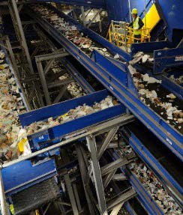
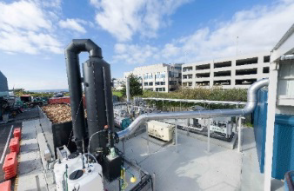
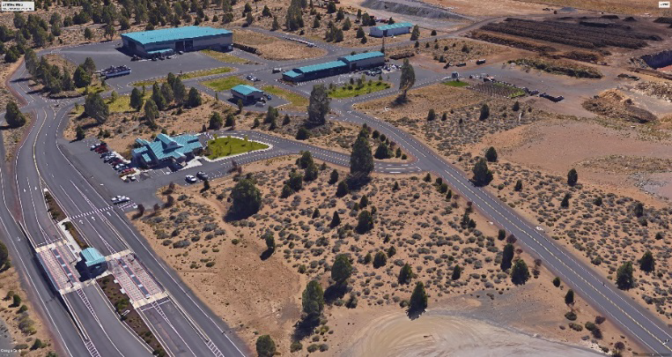
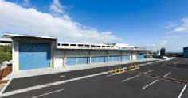





Slide 2
SWAC Agenda : April 24, 2018
Chapter 4 – Collection and Recycling Processing Discussion
    Review New Material
    Review Needs and Opportunities
    Collection/Recycling Options
Chapter 3 – Waste Prevention / Reuse and Recycling Analysis
Draft Recommendations
Public Comments
Next Meeting

Slide 3
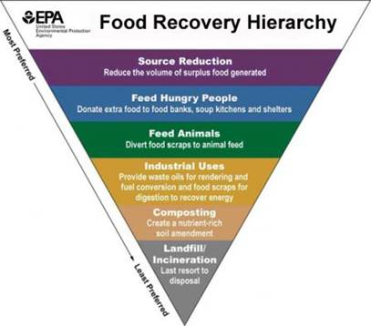
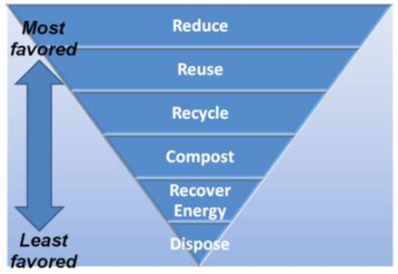
Solid Waste Hierarchy
SWMP Chapter 3 and 4
From Oregon DEQ
From US EPA

Slide 5
Chapter 4 Collection and Recycling Processing Deschutes County Waste Stream 2016
Waste Composition | % of Total Waste | Total Waste (Disposed+ Recyclables) (tons) | Waste Disposed (tons) | % Disposed | Recycled Materials (tons)
Total Paper | 26% | 62,198 | 40,272 | 25% | 21,926
Cardboard/ Kraft | 8% | 18,185 | 5,638 | 4% | 12,547
Clean Mixed Paper/ ONP | 7% | 15,822 | 6,443 | 4% | 9,379
Mixed Paper | 5% | 11,276 | 11,276 | 7% | -
Compostable / Soiled | 7% | 16,109 | 16,109 | 10% | -
Total Plastics | 6% | 14,327 | 12,887 | 8% | 1,440
Organics | 43% | 102,654 | 67,657 | 42% | 34,997
Yard Debris | 14% | 33,266 | 6,443 | 4% | 26,823
Wood | 9% | 22,330 | 16,109 | 10% | 6,221
Food | 18% | 42,701 | 41,883 | 26% | 818
Other Organics | 2% | 4,357 | 3,222 | 2% | 1,135
Glass | 4% | 9,786 | 3,222 | 2% | 6,564
Metal | 8% | 19,844 | 11,276 | 7% | 8,568
Aluminum | 1% | 2,230 | 1,611 | 1% | 619
Tin Cans | 1% | 3,549 | 3,222 | 2% | 327
Other (Scrap Metal) | 6% | 14,065 | 6,443 | 4% | 7,622
Other Inorganics | 9% | 21,584 | 19,330 | 12% | 2,254
Rock/ Concrete/ Brick | 3% | 6,033 | 4,833 | 3% | 1,200
Gypsum Wallboard | 2% | 4,833 | 4,833 | 3% | -
Electronics | 1% | 2,663 | 1,611 | 1% | 1,052
Misc. Organics | 5% | 11,278 | 11,276 | 7% | 2
Other Materials | 4% | 10,055 | 6,443 | 4% | 3,612
Motor Oil | 1% | 2,245 | 322 | 0.20% | 1,923
Other Materials | 3% | 6,522 | 4,833 | 3% | 1,689
Other Recyclables | 0% | 396 | - | 0% | 396
Total Waste | 100% | 240,844 | 161,087 | 100% | 79,757
Commodities
(41,077 tpy)
Source Separation
MRF
Organics (48,326 tpy)
Yard Waste
Food Waste
Other (32,218 tpy)
Wood
Compostable Paper
Total - 121,621 tpy
Goal Recover – 33%
- 40,000 tpy

Slide 6
Analysis:
Collection and Recycling/Processing (1)
Need/Alternative Identified | Key Point | Expansion Program/New Program | Consistent With Hierarchy | Reduces Long-term Generation | Highest and Best Use | Cost Effective and Stabilizes Rates Long-term | Flexibility | Examples
Target OCC and Scrap metal from Commercial | DEQ Commercial target of 55% | New | Yes | No | Yes | Yes | No only 2 materials | Royal Oak Recycling
Residential expansion of recycling, yard waste/food waste, glass | Consider universal service | Expansion | Yes | No | Yes | Yes | Yes | Fort Worth
Multifamily program | Compliance with DEQ by 2022 | New | Yes | No | Yes | Yes | Yes | Marion County
Tourism/hospitality focus | More tourists than residents in County | Expansion/New | Yes | No | Yes | Yes | Yes | Clean the World
Rate Incentives | Use to impact behavior change | New | NA | Yes | Yes | Yes | Yes | Seattle
Target commercial dry waste | Ties into food waste program; dry waste could be processed with residential recycling | New | Yes | No | Yes | Yes | Yes | San Francisco

Slide 7
Analysis:
Collection and Recycling/Processing (2)
Need/Alternative Identified | Key Point | Expansion Program/New Program | Consistent With Hierarchy | Reduces Long-term Generation | Highest and Best Use | Cost Effective and Stabilizes Rates Long-term | Flexibility | Examples
Target food waste (curbside and commercial) | Highest opportunity; product can be used in-County | Expansion | Yes | No | Yes | Yes | Yes | Cambridge, MA
Explore textiles | High favor with residents | New | Yes | No | Yes | Yes | No | SMART
Add C&D program/processing | 25- 30% of material entering landfill now; Simple line could work at Knott | New | Yes | No | Yes | Yes | Yes | Virginia
Build a MRF | -Commingled MRF -Integrated Mixed Waste Processing with MRF | New | Yes | No | Yes | Yes | Yes | Monterey San Jose LA County
Upgrade Compost Facilities -connect to AD effort in Bend | -Aerated Static Piles (ASP) -In vessel with ASP | Expansion | Yes | No | Yes | Yes | Yes | Greeneville, SC

Slide 8
5
Recycling Strategies
Focus on low hanging fruit
1. Expansion of existing Collection programs
Residential Curbside singles stream to more customers
Yard Waste + Food Waste
2. Multifamily
3. Construction /Demolition Waste

Slide 9
Recycle Program Impacts
Residential Food Waste Collection
Note: Focuses on Non-Packaging vegetative food waste

Slide 10
Recycle Program Impacts
Residential + Commercial Food Waste Collection
Note: Focuses on Non-Packaging vegetative food waste

Slide 11
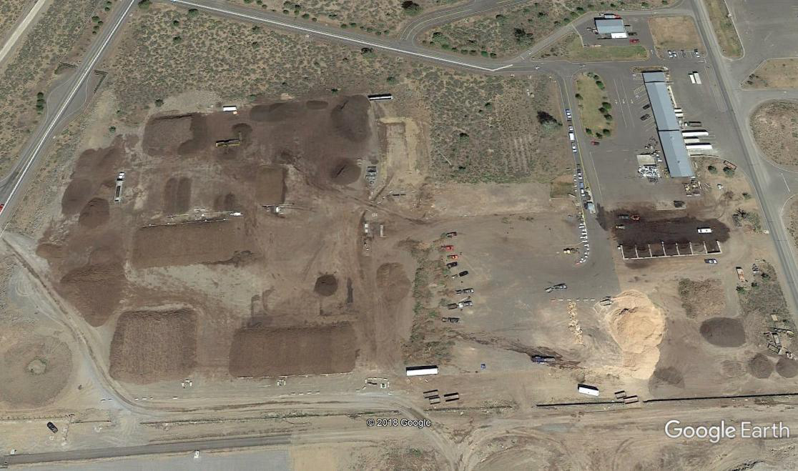
Compost Processing
Deschutes Compost Site ~ 6 Acres
Existing Compost Facility
Tons /Yr
Yard Debris ~ 29,000
Food Waste ~ 1,000 Total ~ 30,000
Expand Food Waste Collection
Residential Est. 4,000 – 8,000
Commercial Est. 4,000 – 8,000
Total New Organics 8,000 – 16.000
Future Organics/Compost 38,000 – 46,000

Slide 12
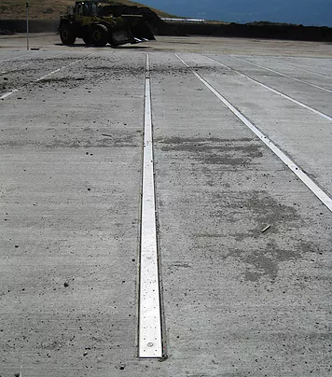
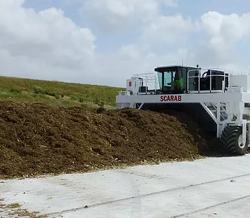
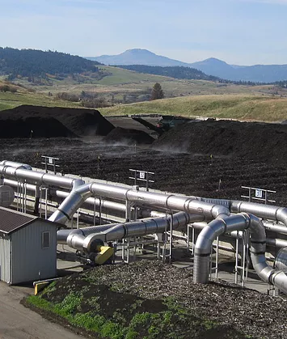
Compost Technologies
Aeration Floors
Aerated Turned Pile (ATP)
Aerated Static Pile (ASP)
*(Photos curtesy of Engineered Compost Systems, www.compostsystems.com)

Slide 13
Compost Technologies
1. Aerated Static Pile - 36,000 tpy approx. 100 tpd
Capital cost ~ $ 3 M - $ 4 M
Includes- ASP Systems; Site Improvements; Process Equipment; Bio-Filter
Primary Retention – 18 days
Secondary Retention – 22 to 30 days
2. In Vessel SV Composter
Capital cost ~ $ 5.5 M - $ 6M
Includes- In- vessel units; Site Improvements; Process Equipment; Bio-Filter
Primary Retention – 18 days
Cure time varies based on materials
Operating Cost - $20 to $30 per ton * (Estimates provided by ECS)

Slide 14
5
Expand Organics / Compost
Implementation Strategy
Expand food waste collection
Conduct compost market study
Consider best site for future operations
Evaluate Technology Options
Establish financial /rates

Slide 15
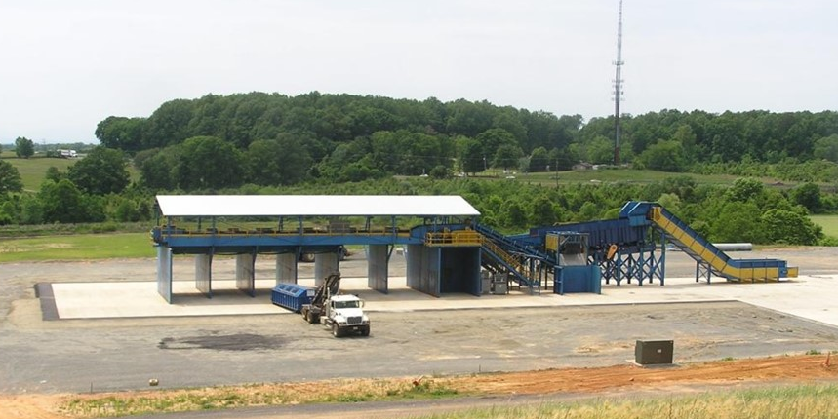
5
Construction / Demolition Waste
Estimated C/D Waste at Knott Landfill
Total Waste Disposed 181,000 tpy (2017)
C/D Waste 25-30% 45,000-54,000 tpy
Composition*
Fines/ Dirt 35%
Wood/ Green Waste 10%
Roofing Material 2%
Scrap Metal 4%
All Commodities 3%
  Cardboard/ Paper
  Containers
  Rigid Plastics
All Other Materials 46%
*Source: Monterey C/D and Self Haul Composition Data

Slide 16
5
Impacts of New Recycling Programs
Food Waste + C/D

Slide 17
5
Impacts on Diversion
Food Waste + C/D
Includes Inerts

Slide 18
Chapter 3: DRAFT RECOMMENDATIONS
Waste Prevention, Reduction, Reuse, and Recycling
MAINTAIN/CONTINUE:
Develop and execute a coordinated promotion and education program with cities, franchise collection companies, The Environmental Center and other entities needed to support ongoing waste prevention, reuse and recycling efforts.
Fund these programs to, at a minimum, maintain the level of participation in reducing waste disposed in landfills.
Evaluate program impacts and examine innovative approaches to inform the public and businesses to reach an ever-growing population and new employers.
NEW PROGRAMS:
Target expansion in participation at multifamily developments, including hotels and resort communities for targeting the year-round tourist population
Expand collection of vegetative waste with yard waste and consider universal service
Expand and develop new programs aimed at increasing recycling by businesses or commercial generators

Slide 19
5
Next Steps
Complete Draft Recommendations for Waste Reduction, Reuse and Recycling (Chapters 3 & 4)
Determine Timeframe for Public Meeting
Next SWAC – May 22 nd
Chapter 5 - Transfer Stations

