Slide 1


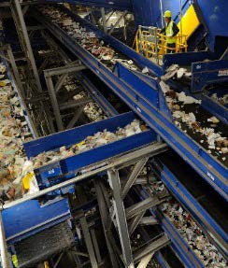
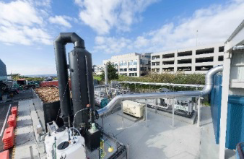
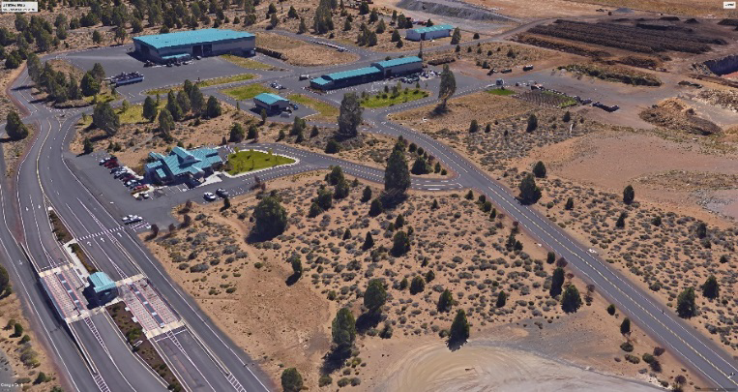
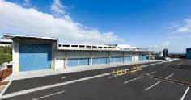





Slide 2
5
SWAC Agenda: May 2018
Introduction – Timm Schimke
    Public Comments – SWAC will invite comments from the public at select times throughout the meeting
Approval of Minutes
Review of Actions
Chapter 4 – Collection and Recycling Processing – Discussion
    Review Food Waste Data
    Draft Recommendations
Chapter 3 – Waste Prevention / Reuse and Recycling Analysis Draft Recommendations
Next Meeting

Slide 3
5
SWAC Agenda: May 2018
3. Review of Actions
  Chapters 3 and 4 have been updated – major changes are highlighted
  In Chapter 3 – added C/D to options shown in Needs and Opportunities
  Chapter 4- Added information on food and C/D wastes materials
  d. Draft Recommendations are described in more detail
  e. Draft Recommendations includes discussion of rational

Slide 4
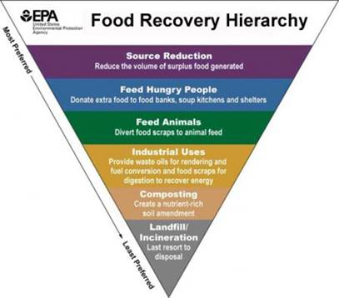
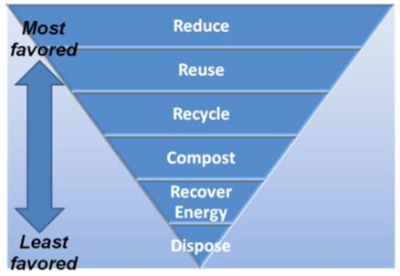
5
Solid Waste Hierarchy
SWMP Chapter 3 and 4
From Oregon DEQ
From US EPA

Slide 5
5
Chapter 4 Collection & Recycling Processing Deschutes County Waste Stream 2016
Waste Composition | % of Total Waste | Total Waste (Disposed+ Recyclables) (tons) | Waste Disposed (tons) | % Disposed | Recycled Materials (tons)
Total Paper | 26% | 62,198 | 40,272 | 25% | 21,926
Cardboard/ Kraft | 8% | 18,185 | 5,638 | 4% | 12,547
Clean Mixed Paper/ ONP | 7% | 15,822 | 6,443 | 4% | 9,379
Mixed Paper | 5% | 11,276 | 11,276 | 7% | -
Compostable / Soiled | 7% | 16,109 | 16,109 | 10% | -
Total Plastics | 6% | 14,327 | 12,887 | 8% | 1,440
Organics | 43% | 102,654 | 67,657 | 42% | 34,997
Yard Debris | 14% | 33,266 | 6,443 | 4% | 26,823
Wood | 9% | 22,330 | 16,109 | 10% | 6,221
Food | 18% | 42,701 | 41,883 | 26% | 818
Other Organics | 2% | 4,357 | 3,222 | 2% | 1,135
Glass | 4% | 9,786 | 3,222 | 2% | 6,564
Metal | 8% | 19,844 | 11,276 | 7% | 8,568
Aluminum | 1% | 2,230 | 1,611 | 1% | 619
Tin Cans | 1% | 3,549 | 3,222 | 2% | 327
Other (Scrap Metal) | 6% | 14,065 | 6,443 | 4% | 7,622
Other Inorganics | 9% | 21,584 | 19,330 | 12% | 2,254
Rock/ Concrete/ Brick | 3% | 6,033 | 4,833 | 3% | 1,200
Gypsum Wallboard | 2% | 4,833 | 4,833 | 3% | -
Electronics | 1% | 2,663 | 1,611 | 1% | 1,052
Misc. Organics | 5% | 11,278 | 11,276 | 7% | 2
Other Materials | 4% | 10,055 | 6,443 | 4% | 3,612
Motor Oil | 1% | 2,245 | 322 | 0.20% | 1,923
Other Materials | 3% | 6,522 | 4,833 | 3% | 1,689
Other Recyclables | 0% | 396 | - | 0% | 396
Total Waste | 100% | 240,844 | 161,087 | 100% | 79,757
Commodities
(41,077 tpy)
Source Separation
MRF
Organics (48,326 tpy)
Yard Waste
Food Waste
Other (32,218 tpy)
Wood
Compostable Paper
Total - 121,621 tpy
Goal Recover – 33%
- 40,000 tpy

Slide 6
5
Food Waste Disposed –
DEQ Composition Study 2016-17
Oregon Waste Composition Study Statewide Results (2016-17) | All Substreams | Residential Route Trucks | Commercial Route | Mixed Route | Compacting Drop Boxes
ALL OTHER ORGANICS | 50.61% | 48.57% | 46.14% | 48.05% | 49.52%
All food | 14.92% | 23.39% | 24.57% | 20.19% | 24.33%
Non-packaged bakery goods | 0.66% | 0.76% | 1.19% | 0.99% | 1.09%
Packaged bakery goods | 0.81% | 1.51% | 1.01% | 0.91% | 1.67%
Non-packaged other veg. food | 7.28% | 11.83% | 12.88% | 11.35% | 9.29%
Unpackaged veg edible | 2.09% | 3.13% | 3.07% | 3.22% | 3.77%
Unpackaged veg nonedible | 5.19% | 8.70% | 9.81% | 8.13% | 5.52%
Packaged other vegetative food | 2.58% | 4.12% | 3.50% | 2.40% | 3.94%
Non-packaged non-vegetative food | 2.07% | 2.70% | 3.92% | 3.15% | 4.26%
Unpkg edible meat, eggs, dairy | 0.72% | 1.00% | 1.11% | 1.24% | 1.80%
Unpkg nonedible animal food- related | 0.61% | 0.87% | 0.72% | 0.92% | 0.61%
Mixed unpackaged foods | 0.74% | 0.83% | 2.09% | 1.00% | 1.84%
Packaged non-vegetative food | 1.52% | 2.47% | 2.06% | 1.39% | 4.09%
Packaged meat, eggs | 0.78% | 1.34% | 0.89% | 0.51% | 2.96%
Packaged dairy | 0.37% | 0.63% | 0.60% | 0.40% | 0.48%
Mixed packaged foods | 0.37% | 0.50% | 0.57% | 0.48% | 0.65%
All edible food | 9.11% | 13.82% | 14.04% | 11.14% | 18.20%
All non-edible food | 5.81% | 9.58% | 10.52% | 9.05% | 6.13%
Yard Debris | 2.40% | 3.90% | 1.86% | 2.44% | 0.75%
All Wood | 15.30% | 2.80% | 8.53% | 8.63% | 8.97%
Remaining Other Organics* | 18.00% | 18.48% | 11.19% | 16.79% | 15.47%

Slide 7
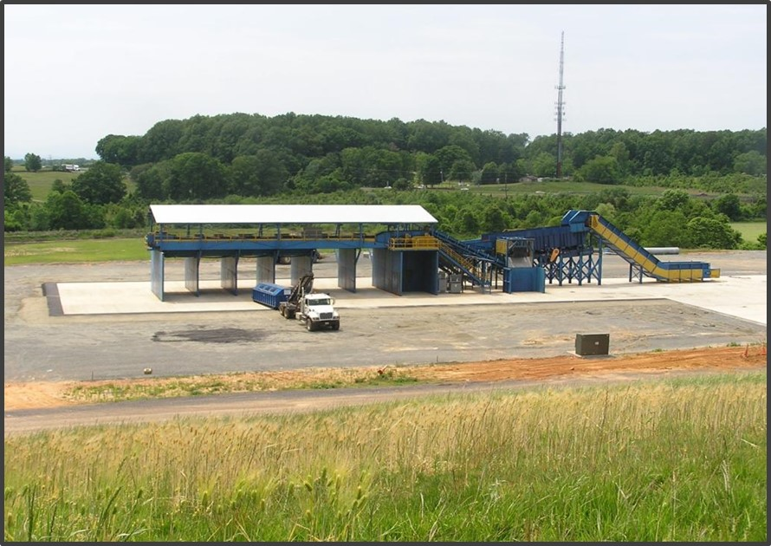
5
Construction / Demolition Waste
Estimated C/D Waste at Knott Landfill
Total Waste Disposed 181,000 tpy (2017)
C/D Waste 25-30% 45,000-54,000 tpy
Composition*
Fines/ Dirt 35%
Wood/ Green Waste 10%
Roofing Material 2%
Scrap Metal 4%
All Commodities 3%
  Cardboard/ Paper
  Containers
  Rigid Plastics
All Other Materials 46%
*Source: Monterey C/D and Self Haul Composition Data

Slide 8
5
Recycle Program Impacts Residential Food Waste Collection
Note: Focuses on Non-Packaging Vegetative Food Waste

Slide 9
5
Recycle Program Impacts
Residential + Commercial Food Waste Collection
Note: Focuses on Non-Packaging Vegetative Food Waste

Slide 10
5
Impacts of New Recycling Programs
Food Waste + C/D

Slide 11
5
Impacts on Diversion
Food Waste + C/D
Includes Inerts

Slide 12
5
Analysis:
Collection and Recycling/Processing (1)
Need/Alternative Identified | Key Point | Expansion Program/New Program | Consistent With Hierarchy | Reduces Long-term Generation | Highest and Best Use | Cost Effective and Stabilizes Rates Long-term | Flexibility | Examples
Target OCC and Scrap metal from Commercial | DEQ Commercial target of 55% | New | Yes | No | Yes | Yes | No only 2 materials | Royal Oak Recycling
Residential expansion of recycling, yard waste/food waste, glass | Consider universal service | Expansion | Yes | No | Yes | Yes | Yes | Fort Worth
Multifamily program | Compliance with DEQ by 2022 | New | Yes | No | Yes | Yes | Yes | Marion County
Tourism/hospitality focus | More tourists than residents in County | Expansion/New | Yes | No | Yes | Yes | Yes | Clean the World
Rate Incentives | Use to impact behavior change | New | NA | Yes | Yes | Yes | Yes | Seattle
Target commercial dry waste | Ties into food waste program; dry waste could be processed with residential recycling | New | Yes | No | Yes | Yes | Yes | San Francisco

Slide 13
5
Analysis:
Collection and Recycling/Processing (2)
Need/Alternative Identified | Key Point | Expansion Program/New Program | Consistent With Hierarchy | Reduces Long-term Generation | Highest and Best Use | Cost Effective and Stabilizes Rates Long-term | Flexibility | Examples
Target food waste (curbside and commercial) | Highest opportunity; product can be used in-County | Expansion | Yes | No | Yes | Yes | Yes | Cambridge, MA
Explore textiles | High favor with residents | New | Yes | No | Yes | Yes | No | SMART
Add C&D program/processing | 25- 30% of material entering landfill now; Simple line could work at Knott | New | Yes | No | Yes | Yes | Yes | Virginia
Build a MRF | -Commingled MRF -Integrated Mixed Waste Processing with MRF | New | Yes | No | Yes | Yes | Yes | Monterey San Jose LA County
Upgrade Compost Facilities -connect to AD effort in Bend | -Aerated Static Piles (ASP) -In vessel with ASP | Expansion | Yes | No | Yes | Yes | Yes | Greeneville, SC

Slide 14
5
Recycling Strategies
Priorities
1. Expansion of existing Collection programs
Residential Curbside singles stream to more customers
Yard Waste + Food Waste
2. Alternatives for managing Construction /Demolition Waste
3. Multifamily /Commercial Recyclables
Rational
Programs are consistent with state hierarchical priorities and goals to reduce waste disposed in landfill
Seeks to attain highest use of resources to convert organics to soil amendment / enrichment
Requires minimal investment to reduce waste disposed at Knott and attain long term stability is managing waste versus transport to more distant landfill
Does not rely on markets outside geographical area
Programs are flexible to expand or contract with minimal impacts to system

Slide 15
5
Chapter 4 – Residential Food Waste
Expand residential collection of vegetative food waste with yard waste. Elements of implementing this recommendation include:
  Establish a consistent collection program in cities, urbanized areas and unincorporated areas of the County.
  Evaluate rate incentives to encourage participation.
  Develop and implement promotion and education programs to support the collection system.

Slide 16
5
Chapter 4 – Residential Food Waste
Conduct an assessment of markets for products made from compost. The study should consider alternatives that include other byproducts.
a. Sludge management at the City’s wastewater treatment plant
b. Waste from breweries.

Slide 17
5
Chapter 4 – Organics Composting
Evaluate the alternatives to enhance and expand composting facilities.
The study should evaluate the most optimal location considering proximity to generators, markets and surrounding land uses.

Slide 18
5
Chapter 4 – Organics Composting
Upgrade organics processing capacity to handle additional yard waste/food waste, including meats and dairy from residential and commercial sources.
Assumes:
Expand collection programs to collect all food waste when permits are secured.

Slide 19
5
Chapter 4 – C/D Recommendations
Develop a plan to minimize disposal of C/D wastes at Knott Landfill.
  Assess quantity and composition of C/D accepted at Knott Landfill.
  Based on assessment results, evaluate options to reduce the amount of C/D disposed.
  Consider alternatives to incentivize generators to reduce and reuse C/D materials.

Slide 20
5
Chapter 3: DRAFT RECOMMENDATIONS
Waste Prevention, Reduction, Reuse, and Recycling
MAINTAIN / CONTINUE:
Develop and execute a coordinated promotion and education program with cities, franchise collection companies, The Environmental Center and other entities needed to support ongoing waste prevention, reuse and recycling efforts.
Fund these programs to, at a minimum, maintain the level of participation in reducing waste disposed in landfills.
Evaluate program impacts and examine innovative approaches to inform the public and businesses to reach an ever-growing population and new employers.
NEW PROGRAMS:
Expand collection of vegetative food waste with yard waste and consider universal service.
Target expansion in participation at multifamily developments, including hotels and resort communities for targeting the year-round tourist population.
Expand and develop new programs aimed at increasing recycling by businesses or commercial generators.

Slide 21
5
Next Steps
1. Complete Draft Recommendations for Waste Reduction, Reuse and Recycling (Chapters 3 & 4)
2. Determine Timeframe for Public Meeting – June Meeting ?
3 Weeks Public Notice
3. Next SWAC June 26th
Chapter 5 - Transfer Stations
July 24th
Chapter 6 - Disposal Alternatives (1st meeting)

