Slide 1


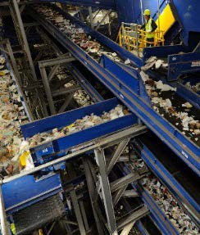
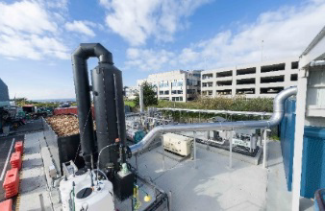
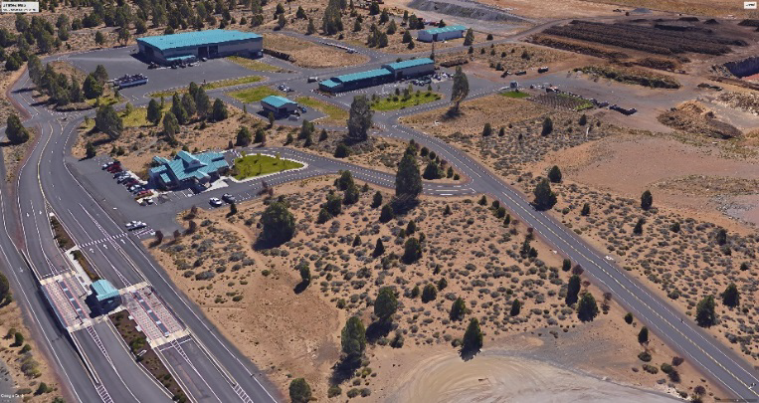
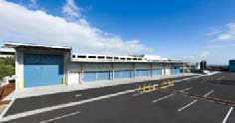





Slide 2
5
SWAC Agenda: June 2018
Introduction – Timm Schimke
Approval of Minutes
Note: Public Comments –SWAC will invite comments from the public at select times throughout meeting
Review of Actions
Review of Public Meeting
Chapter 5 – Transfer Stations
- Existing Conditions
      Review of Current System and Services
      Negus
      Southwest
      Northwest &Alfalfa
- Need and Opportunities
Next Meeting

Slide 3
5
Actions from May SWAC Meeting
3. Review of Actions
Revised Food Waste Table will be inserted in Draft Chapter
Summary of rational for recommendations will use a bullet format unless a description is required
Revisions suggested by SWAC will be incorporated into next Draft of Chapter to be completed after the public meeting.

Slide 4
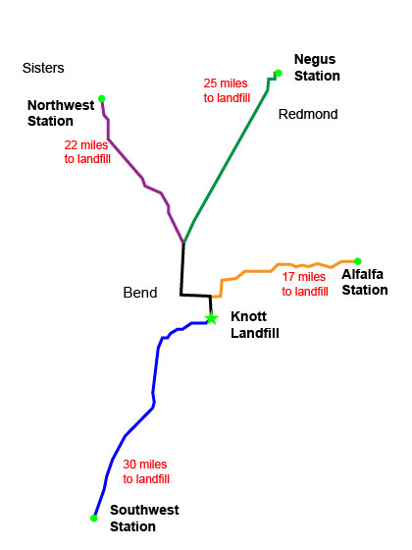
5
Transfer Stations
Existing Conditions
Negus Transfer Station—Services the City of Redmond and surrounding areas including unincorporated areas.
Southwest Transfer Station—Services the City of La Pine, Sunriver Resort, and other unincorporated areas in the southwest region of the County.
Northwest Transfer Station—Services the City of Sisters, Black Butte Ranch, and other unincorporated areas in the northwest region of the County.
Alfalfa Transfer Station—Services the eastern areas of the County.
The Knott Landfill Transfer Station

Slide 5
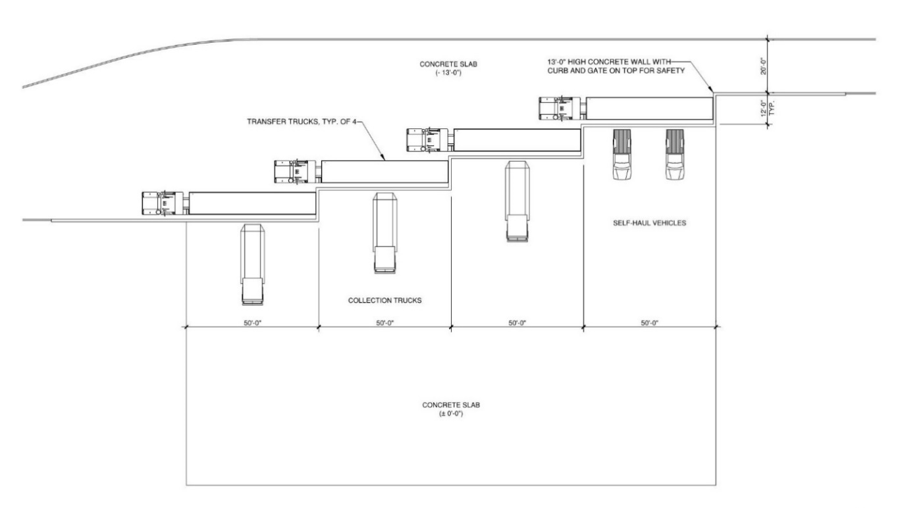
5
Facility Operations

Slide 6
5
County Transfer Station Operations

Slide 7
5
Waste Volumes at Transfer Stations

Slide 8
5
Vehicle Traffic at Transfer Stations

Slide 9
5
Recycling at Transfer Stations

Slide 10
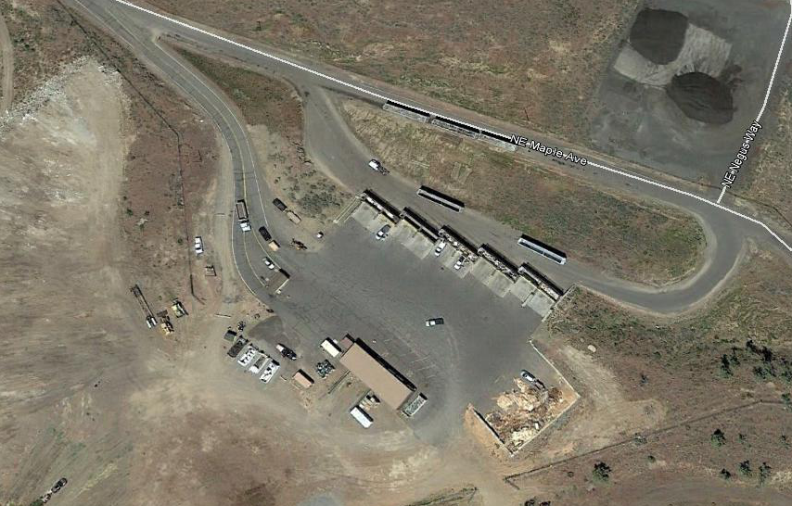
5
Negus Transfer Station
Possible expansion of the recycling center
Separation of commercial from self haul vehicle traffic
Covered or enclosed areas for vehicle receiving and unloading
Improve inbound and outbound scales and a scale house.
Areas on site for receiving and storing food waste, C&D wastes, yard debris, and wood waste.

Slide 11
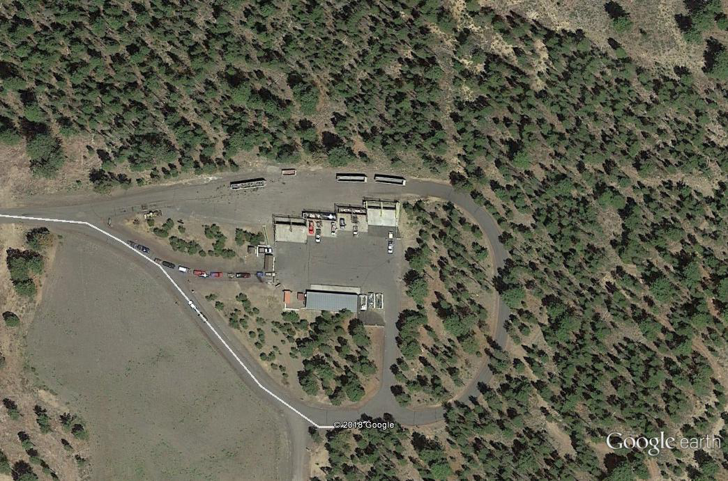
5
Southwest Transfer Station
Possible expansion of the recycling center
Separation of commercial from self haul vehicle traffic
Covered or enclosed areas for vehicle receiving and unloading
Improve inbound and outbound scales and a scale house.
Areas on site for receiving and storing food waste, C&D wastes, yard debris, and wood waste.

Slide 12
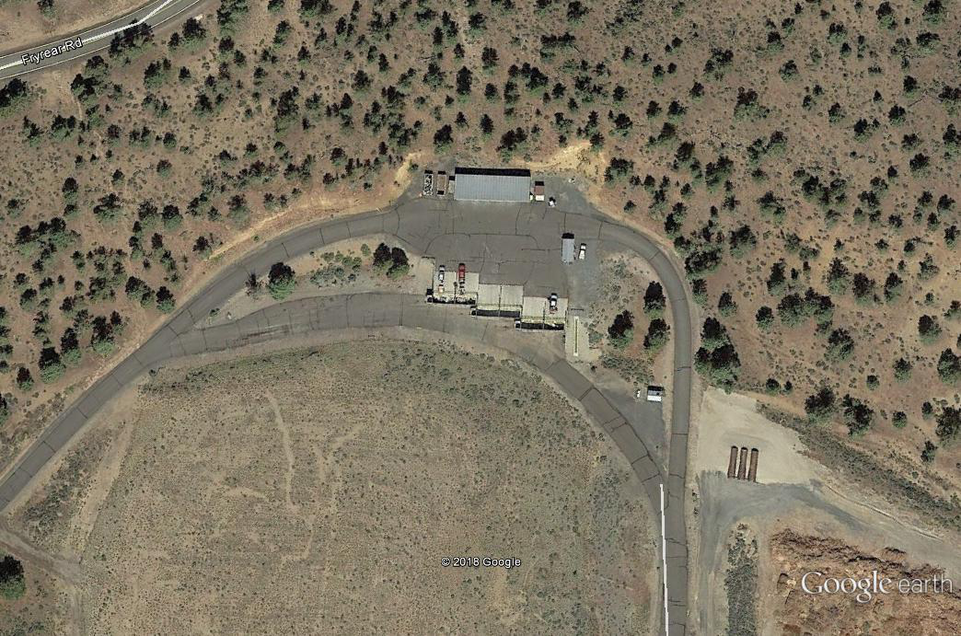
5
Northwest Transfer Station
Facility is opened 4 days/ week
Previously under served
area is now is seeing more
growth
c. No immediate facility
improvements required

Slide 13
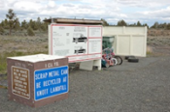
5
Alfalfa Transfer Station
Remote Site – only opened on Saturday
Provides convenient services for rural eastern County
No immediate needs

Slide 14
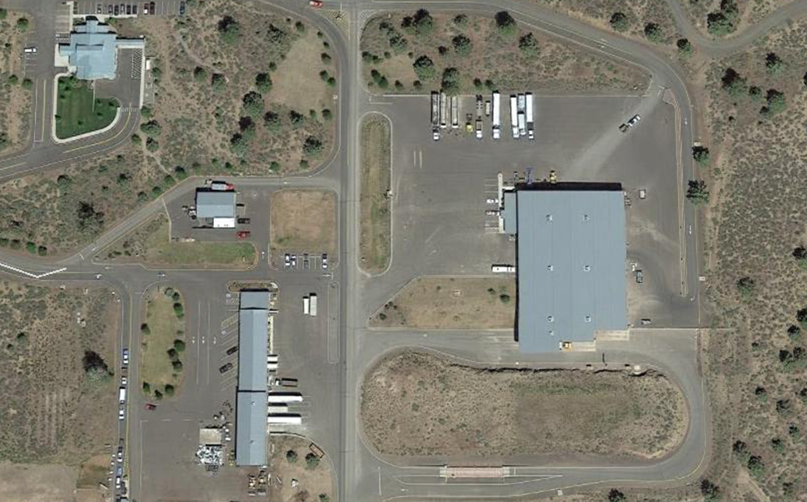
5
Knott Transfer Station
Transfer Station
Recycling Center

Slide 15
5
Knott Transfer Station
Future Improvements / Modifications
a. If a Landfill is located in County
  Continue to receive waste from self haul
  Franchised Collection vehicles depends on location of landfill – but may not accept all waste
b. If a Landfill is located Out of County
  Continue to receive waste form self haul
  Is Expected to play important part of transloading waste from Franchised collection vehicles

Slide 16
5
Knott Transfer Station
Transfer Station System - Future Improvements / Modifications
Develop Facility Plans for both Negus and Southwest
Determine the capital investments and priorities for all transfer stations
Establish a capital improvement program for making investments over the next 10 years.

Slide 17
5
Next Steps
1. Complete Draft Recommendations for Waste Reduction, Reuse and Recycling (Chapters 3 & 4)
2. July Meeting – Review final draft of Chapter 3 and 4
Recommendations based on SWAC input and information from public
3. August Meeting – Draft Alternative Technology / Landfill Chapter 6
Existing Conditions
Technology Review
Disposal Options
Chapter 6 - Disposal Alternatives (1st meeting)
4. Aiming for September Public meeting

