Slide 1


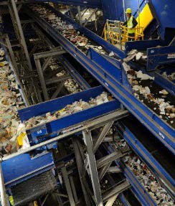
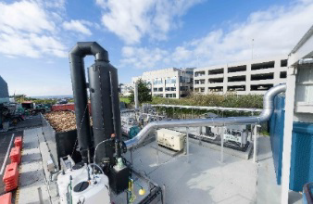
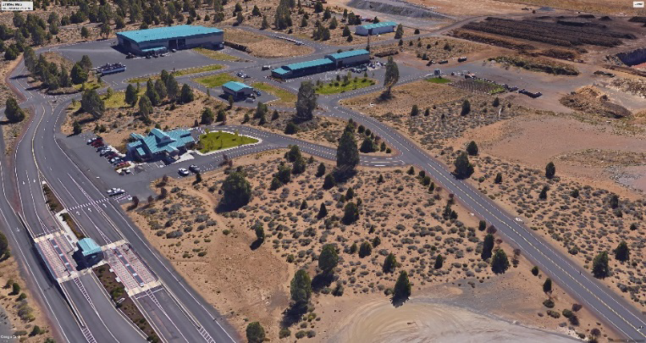
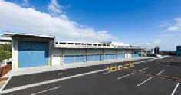





Slide 2
5
SWAC Agenda: July 24th 2018
Introduction – Timm Schimke
Approval of Minutes
Note: Public Comments –SWAC will invite comments from the public at select times throughout meeting
Review of Actions
  Included cost effectiveness definition and rating.
  Outlined rationale per SWAC recommendations.
Review Final Draft Recommendations
Chapter 3 – Waste Reduction and Reuse
Chapter 4 – Collection and Recycling Processing
Chapter 5 – Transfer Stations
Next Meeting – Alternative Technology and Disposal

Slide 3
5
Cost Effectiveness of Alternatives
1) Most cost effective – The alternative will have an immediate (less than 2 years) and measurable impact towards meeting the County’s goals to reduce waste disposed in landfills by reusing, recycling or diverting waste by achieving a higher use of the material as a resource. The alternative does not require significant changes to current collection services or practices resulting in major capital investments. Also, the alternative does not exceed the current cost of disposing in the landfill. The impact to total system cost is minimal.
2) Moderately Cost Effective – The alternative will have measurable impacts towards reducing the waste disposed in landfills and may cost more than the current cost of landfilling. The alternative may require expansion or modifications to existing collection services requiring an increase in rates of more than 10% but less than 30%. However, the alternative will provide a long term cost benefit by extending the site of Knott Landfill, thus delaying the need to purchase additional capacity either by operating a landfill in Deschutes County or other alternative. The alternative may also result in reducing long term costs by reducing the cost to transport to landfill site out of the County. The alternative may also result in preserving jobs and financial resources spent in the County versus to outside entities.
3) Least Cost Effective – The alternative may increase collection cost by over 30% and/or may cost more than the current cost of disposal. The alternative may have long term benefits of reducing waste disposed in landfills and /or keeping long term system cost from increasing over other options. The alternative may also result in preserving jobs and financial resources spent in the County versus to outside entities

Slide 4
5
Waste Prevention, Reduction, Reuse & Recycling Needs & Alternatives Table - Ch. 3
 |  |  | Analysis*
Need/Alternative Identified | Key Point | Expansion Program/New Program | Consistent With Hierarchy | Reduces Long-term Generation | Highest and Best Use | Cost Effective and Stabilizes Rates Long-term | Flexibility | Examples
Standardize Waste Prevention, Reduction, Reuse and Recycling Messaging/Communications | Budget $3.00/HH/year | Expansion/New | Yes | Contributes to effective communication | Yes | Current programs work- more resources needed 1 | Programs are adaptable | Marion County
Reduce Waste Generation | Consider options most desirable to goals | Expansion/New | Yes | Yes | Yes | Not effective without enforcement 1 | Varies | California
Material bans (plastic bags; yard waste/food waste) | Political desire must be there | New | Yes | Yes | Yes | Difficult to measure impact 1 | No | Seattle; Massachusetts
Grasscycling/backyard composting | Good communication point | New | Yes | Yes | Yes | Requires ongoing training program 1 | Yes | Portland Metro
Residential messaging for opt-out programs | Residents appreciate | Expansion | Yes | Yes | Yes | Small impact 1 | Yes | Montgomery County, MD
Food waste apps to increase diversion of usable food | Great for residents and businesses | New | Yes | Yes | Yes | Effective 1 | Yes | New England

Slide 5
5
Waste Prevention, Reduction, Reuse & Recycling Needs & Alternatives Table - Ch. 3
 |  |  | Analysis*
Need/Alternative Identified | Key Point | Expansion Program/New Program | Consistent With Hierarchy | Reduces Long-term Generation | Highest and Best Use | Cost Effective and Stabilizes Rates Long-term | Flexibility | Examples
Stimulate reuse | Build from thrift stores and donation centers (i.e. Goodwill) | Expansion | Yes | Extends useful life of products | Yes | Saves system cost 1 | Yes | Fauquier County, VA
Outreach and events diversion | Support event and venue diversion | Expansion/New | Yes | Yes | Yes | Requires resources 1 | Yes | Kent County, MI
Continue Waste Reduction/Recycling Grants | Allow for individual and group projects | Expansion | Yes | Yes | Yes | NA | Yes | North Carolina; Oakland, CA
Promote Increased Diversion from the Waste Stream | Increase awareness of collection points; utilize Waste Wizard or other application | Expansion | Yes | Yes | Yes | Yes 1 | Yes | Tampa and Hillsborough County, FL
Encourage hotels and tourist centers to focus on WR/R | Ties into commercial/multifamily program | New | Yes | Yes | Yes | Yes 1 | Yes | Vail, CO; Whistler, BC; Park City, UT; Big Sky, MT
Expand Commercial/Multifamily Recycling and Food Waste Recovery | Large opportunity for diversion; add staff, increase partner funding allocation, & explore University partnership | Expansion/New | Yes | Yes | Yes | Requires persistent promotion/education rate incentive 2 | Yes | Seattle; Portland Metro

Slide 6
5
Waste Prevention, Reduction, Reuse & Recycling Needs & Alternatives Table - Ch. 3
 |  |  | Analysis*
Need/Alternative Identified | Key Point | Expansion Program/New Program | Consistent With Hierarchy | Reduces Long-term Generation | Highest and Best Use | Cost Effective and Stabilizes Rates Long-term | Flexibility | Examples
Residential Yard Waste/Food Waste | Make service consistent across County | Expansion | Yes | Yes | Yes | Increase subscribers to pay, reduces waste transport distance 2 | Yes | Minneapolis, MN
Commercial/Demolition (C/D) program development | Estimated 30% of Knott Landfill is C/D but no outreach program in place | New | Yes | Yes | Yes | Yes 2 | Yes | Virginia

Slide 7
5
Chapter 3 Recommendations
3.1 Recommendation: Move toward a standard WR/R program throughout the county for single family, multifamily and businesses that includes a comprehensive education and outreach program.
3.2 Recommendation: Develop a standard for a multifamily recycling program that includes a comprehensive education and outreach program to expand participation at multifamily developments.

Slide 8
5
Chapter 3 Recommendations
3.3 Recommendation: Expand business education and promotion to target expansion of recycling, focusing especially on hotels and resort communities to reach the year-round tourist population. As part of the business education and promotion program, also develop a program to target food waste recovery (see also Recommendation 3.4).

Slide 9
5
Chapter 3 Recommendations
3.4 Recommendation: Expand and develop additional materials to educate households, multifamily and businesses on how to reduce food waste and develop promotion of vegetative waste with yard waste and consider universal service.

Slide 10
5
Chapter 3 Recommendations
3.5 Recommendation: Expand and develop new programs aimed at increasing recycling of C/D materials.

Slide 11
5
Cost Effectiveness of Alternatives
1) Most cost effective – The alternative will have an immediate (less than 2 years) and measurable impact towards meeting the County’s goals to reduce waste disposed in landfills by reusing, recycling or diverting waste by achieving a higher use of the material as a resource. The alternative does not require significant changes to current collection services or practices resulting in major capital investments. Also, the alternative does not exceed the current cost of disposing in the landfill. The impact to total system cost is minimal.
2) Moderately Cost Effective – The alternative will have measurable impacts towards reducing the waste disposed in landfills and may cost more than the current cost of landfilling. The alternative may require expansion of modifications to existing collection services requiring an increase in rates of more than 10% but less than 30%. However, the alternative will provide a long term cost benefit by extending the site of Knott Landfill, thus delaying the need to purchase additional capacity either by operating a landfill in Deschutes County or other alternative. The alternative may also result in reducing long term costs by reducing the cost to transport to landfill site out of the County. The alternative may also result in preserving jobs and financial resources spent in the County versus to outside entities.
3) Least Cost Effective – The alternative may increase collection cost by over 30% and/or may cost more than the current cost of disposal. The alternative may have long term benefits of reducing waste disposed in landfill and /or keeping long term system cost from increasing over other options. The alternative may also result in preserving jobs and financial resources spent in the County versus to outside entities.

Slide 12
5
Collection and Recycling/ Processing Alternatives Analysis Table - Ch. 4
 |  |  | Analysis*
Need/Alternative Identified | Key Point | Expansion Program/New Program | Consistent With Hierarchy | Reduces Long-term Generation | Highest and Best Use | Cost Effective and Stabilizes Rates Long-term | Flexibility | Examples
Target OCC and Scrap metal from Commercial | DEQ Commercial target of 55% | New | Yes | No | Yes | Can add to current collection 1 | No Only 2 Materials | Royal Oak Recycling
Residential expansion of recycling, yard waste/food waste, glass | Consider universal service | Expansion | Yes | No | Yes | Can opt-in to subscribing to service 1 | Yes | Fort Worth
Multifamily program | Compliance with DEQ by 2022 | New | Yes | No | Yes | Can expand current service 2 | Yes | Marion County
Tourism/hospitality focus | More tourists than residents in County | Expansion/New | Yes | No | Yes | Economic driver 2 | Yes | Clean the World
Rate Incentives | Use to impact behavior change | New | NA | Yes | Yes | Very effective 2 | Yes | Seattle
Target commercial dry waste | Ties into food waste program; dry waste could be processed with residential recycling | New | Yes | NO | Yes | Can add to current collection 1 | Yes | San Francisco

Slide 13
5
Collection and Recycling/ Processing Alternatives Analysis Table - Ch. 4
 |  |  | Analysis*
Need/Alternative Identified | Key Point | Expansion Program/New Program | Consistent With Hierarchy | Reduces Long-term Generation | Highest and Best Use | Cost Effective and Stabilizes Rates Long-term | Flexibility | Examples
Target food waste (curbside and commercial) | Highest opportunity; product can be used in-County | Expansion | Yes | No | Yes | Extends landfill life 2 | Yes | Cambridge, MA
Explore Textiles | High favor with residents | New | Yes | No | Yes | Lower impact 1 | No | SMART
Add C/D program/processing | 30% of material entering landfill now; Simple line could work at Knott | New | Yes | No | Yes | Extends landfill life 2 | Yes | Virginia
Build a MRF | -Commingled MRF -Integrated Mixed Waste Processing with MRF | New | Yes | No | Yes | Challenge to justify 3 | Yes | Monterey San Jose LA County
Upgrade Compost Facilities -connect to AD effort in Bend | -Aerated Static Piles (ASP) -In vessel with ASP | Expansion | Yes | No | Yes | Expands current facilities 2 | Yes | Greeneville, SC

Slide 14
5
Chapter 4 Recommendations
4.1 Recommendation: Expand the current residential collection of vegetative food waste with yard waste to increase participation.

Slide 15
5
SWR Rate Study
Ave. 1,000 lbs/yr
Ave. 1,300 -1,400 lbs/yr
Ave. 800 - 900 lbs/yr

Slide 16
5
SWR Rate Study
Table: Rate Components for 20-Gallon Can and 35-Gallon Roll Cart Service

Slide 17
5
Chapter 4 Recommendations
4.2 Recommendation: Conduct an assessment of markets for products made from compost resulting from expanded organics programs.
4.3 Recommendation: Evaluate the alternatives to enhance and expand composting facilities. The study should evaluate the most optimal location considering proximity to generators, markets and surrounding land uses.

Slide 18
5
Chapter 4 Recommendations
4.4 Recommendation: Upgrade the organics processing capacity and technology to efficiently handle additional yard waste/food waste, including meats and dairy, from residential and commercial sources and other organic waste streams.

Slide 19
5
Chapter 4 Recommendations
4.5 Recommendation: Develop a business recycling and food waste collection program targeting businesses, hotels and resort communities.
  4.6 Recommendation: Develop a multifamily recycling and food waste collection program.

Slide 20
5
Chapter 4 Recommendations
  4.7 Recommendation: Develop a plan to provide incentives for recycling of construction material and alternatives to recycle materials from the C/D stream and minimize its disposal at Knott Landfill.

Slide 21
5
Chapter 4 Recommendations
  4.8 Recommendation: The County should complete a waste characterization study to better evaluate options for recovering targeted materials and for designing the programs and facilities needed.
  For Consideration – Recommend establishing Recycling Task Force w/ specific direction to develop and implement strategies

Slide 22
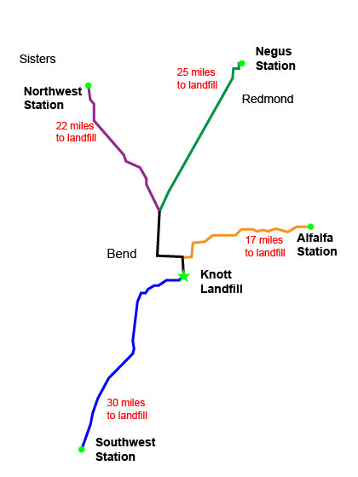
5
Transfer Stations
Existing Conditions
Negus Transfer Station—Services the City of Redmond and surrounding areas including unincorporated areas.
Southwest Transfer Station—Services the City of La Pine, Sunriver Resort, and other unincorporated areas in the southwest region of the County.
Northwest Transfer Station—Services the City of Sisters, Black Butte Ranch, and other unincorporated areas in the northwest region of the County.
Alfalfa Transfer Station—Services the eastern areas of the County.
The Knott Landfill Transfer Station

Slide 23
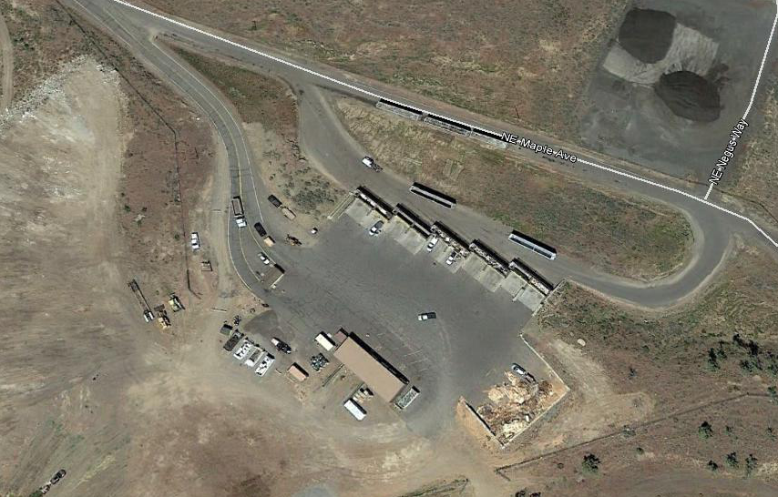
5
Negus Transfer Station
Possible expansion of the recycling center
Separation of commercial from self haul vehicle traffic
Covered or enclosed areas for vehicle receiving and unloading
Improve inbound and outbound scales and a scale house.
Areas on site for receiving and storing food waste, C&D wastes, yard debris, and wood waste.

Slide 24
5
Chapter 5 Recommendations
  5.1 Recommendation: Develop a Facility Plan for the Negus Transfer Station in 2018 for making improvements to the facility by 2021 or as needed.

Slide 25
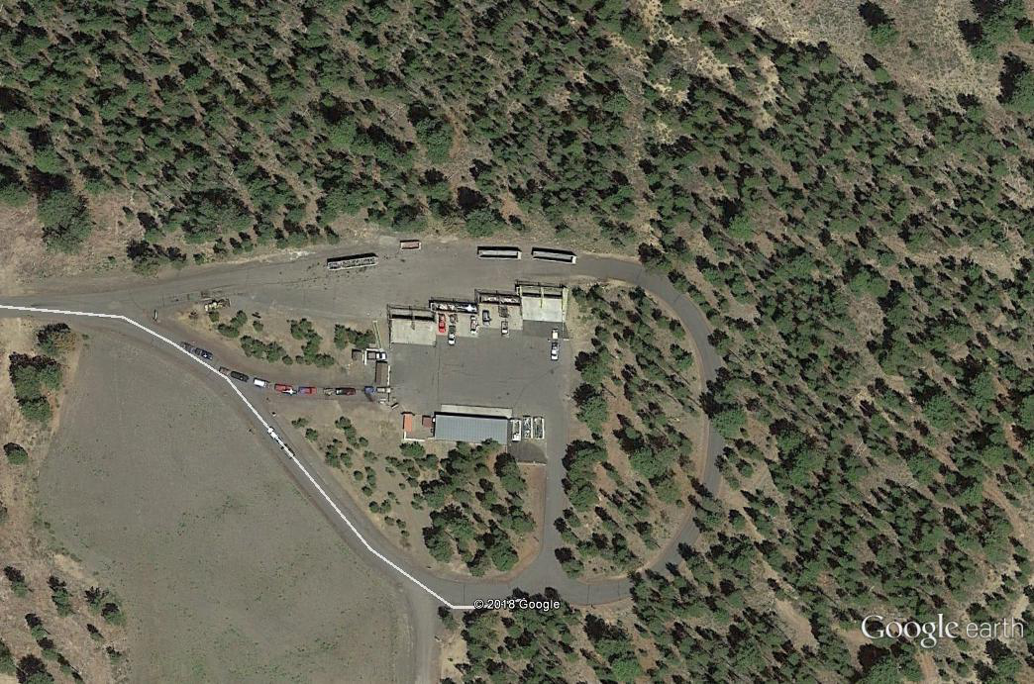
5
Southwest Transfer Station
Possible expansion of the recycling center
Separation of commercial from self haul vehicle traffic
Covered or enclosed areas for vehicle receiving and unloading
Improve inbound and outbound scales and a scale house.
Areas on site for receiving and storing food waste, C&D wastes, yard debris, and wood waste.

Slide 26
5
Chapter 5 Recommendations
  5.2 Recommendation: Develop Facility Plan for the Southwest Transfer Station within the next 3 years. Modifications to the facility can be made as the demand for enhanced services for managing increased waste volumes and traffic is required.

Slide 27
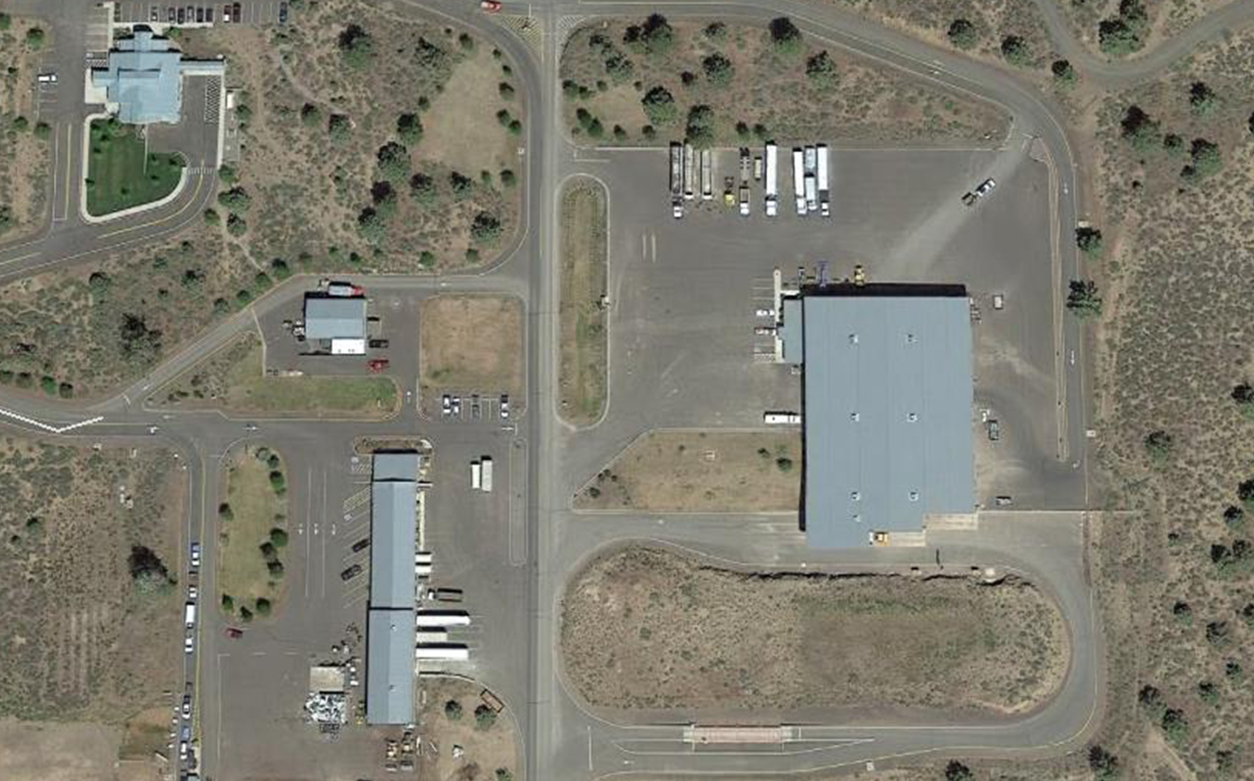
5
Knott Transfer Station
Transfer Station
Recycling Center

Slide 28
5
Knott Transfer Station
Future Improvements / Modifications
a. If a Landfill is located in County
  Continue to receive waste from self haul
  Franchised Collection vehicles depends on location of landfill – but may not accept all waste
b. If a Landfill is located Out of County
  Continue to receive waste from self haul
  Is Expected to play important part of transloading waste from Franchised collection vehicles

Slide 29
5
Chapter 5 Recommendations
  5.3 Recommendation: Develop Facility Plans for the Knott Transfer and Recycling Center as necessary to address the long-term disposal options or within 5 years of closure of Knott Landfill.

Slide 30
5
Chapter 5 Recommendations
  5.4 Recommendation: Establish a capital improvement program for making investments in transfer station modification over the next 10 years.

Slide 31
5
Next Steps
Next SWAC - Aug 28th Chapter 6 Disposal Alternatives (1st meeting)
SWAC Sept - Chapter 6 – 2nd Meeting
Possible Public Meeting - Alternative Technologies/Disposal Options – Early Oct
SWAC Oct - Chapter 6 – Recommendations
SWAC Nov - Chapter 7 - Administrative/Financial
Implementation Approach

