Slide 1


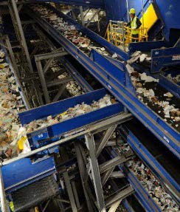
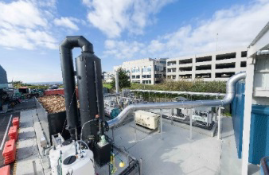
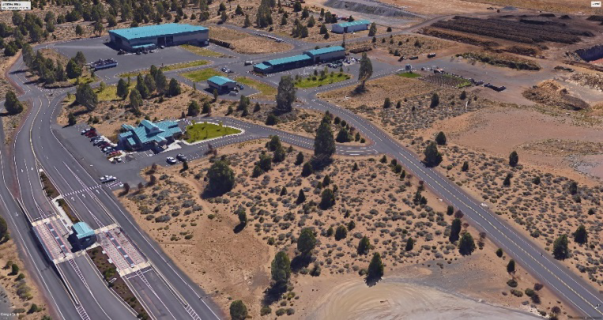
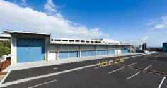





Slide 2
SWAC – Agenda 11/27/18
1. City of Bend – Southeast Development Plan
2. Chapter 7 – Draft Landfill Disposal
      Disposal Options
      - Existing Disposal System
      - Transport to Out of County Landfill
      Crook County
      - Site new In-County Landfill
      Evaluation of Options
3. Review of Summary
4. Schedule of Meetings

Slide 3
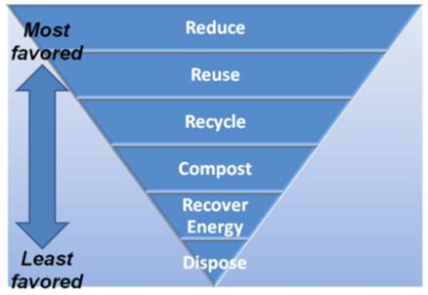
Chapter 7 – Landfill Disposal
State Hierarchy for Managing Waste
First Step
Reduce Waste and Recycle (Chapters 3 & 4)
Alternative Technologies/ Resource
Recovery
Landfill Disposal
From Oregon DEQ

Slide 4
Chapter 7 – Landfill Disposal
Current Disposal / Ton Cost
Total Annual Operating Expenses |  | $ 6,000,000 | $/ Ton
Annual Waste Disposed | 2016 | 161,000 | $37.27
Annual Waste Disposed | 2017 | 181,000 | $33.15
Average Disposal Cost |  |  | $ 35.21

Slide 5
Chapter 7 – Landfill Disposal
Landfill Disposal Options
Transport and dispose at Out of County Site(s)
  Regional Landfill
  Crook County Landfill
Site and Construct a New In-County Landfill

Slide 6
Chapter 7 – Landfill Disposal
Transport and dispose at Out of County Site(s)
  Regional Landfill
  Crook County Landfill

Slide 7
Long-Haul Waste
Regional Landfills
Landfills Located East of Cascades
1) Columbia Ridge Landfill, Arlington, OR. – Owned & Operated by Waste Management
2) Finley Butte Landfill, Boardman, OR – Owned & Operated by Waste Connections
3) Wasco County Landfill, The Dalles, OR – Owned & Operated by Waste Connections
4) Roosevelt Regional Landfill, Roosevelt, WA - Owned & Operated by Republic Services
Landfills Located West of Cascades
5) Coffin Butte Landfill, Corvallis, OR. – Owned & Operated by Republic Services
6) Dry Creek Landfill, Medford, OR, Owned & Operated by Rogue Disposal

Slide 8
Long-Haul Waste
Crook County Landfill (CC)
The Landfill has over 100 Yrs. with current waste flows
CC will accept portion of Deschutes County
Current rates - $35 per ton + $5 Host Fee

Slide 9
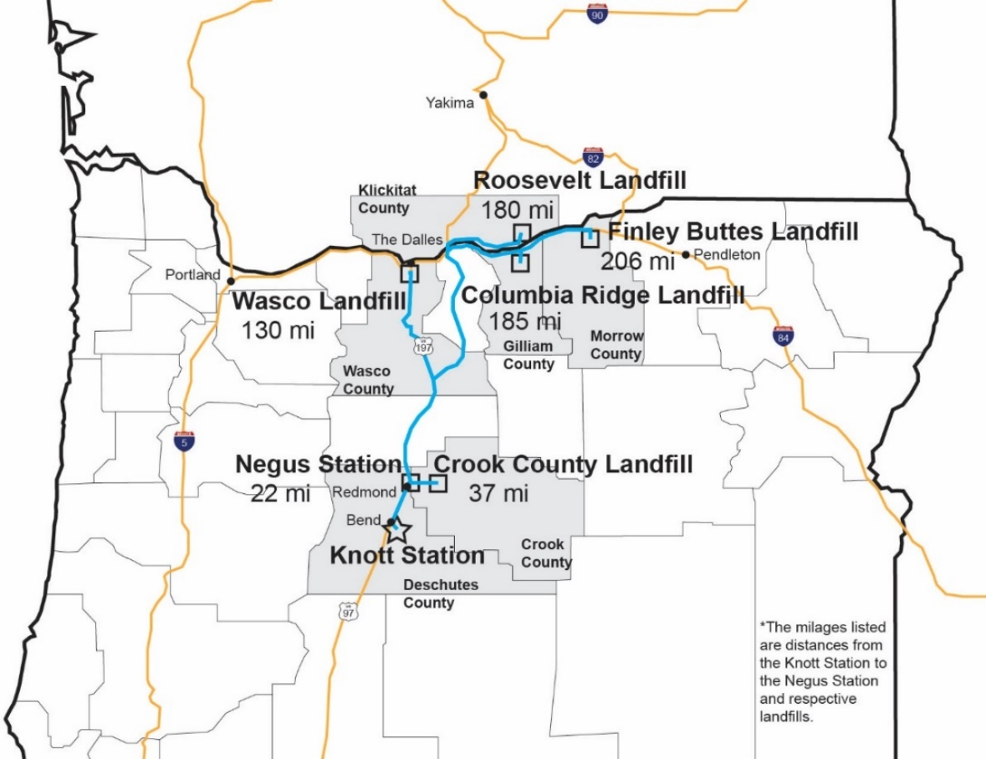
Long-Haul Waste
Location and Distances to Landfills and Transfer Stations

Slide 10
Long-Haul Waste
Knott Transfer Station
Description | Transportation Costs Rounded ($/ton) | Landfill Disposal Costs+ Host Fee ($/ton)(1) | Total Transportation/ Disposal +Host Fee ($/ton) | Transfer Station Costs ($/ton) | Total ($/ton)
Station and Wasco Landfill (135 miles one-way) | $19.00 | $28.00-$31.00 | $47.00-$50.00 | $12.00 | $59.00-$62.00
Station and Columbia Ridge Landfill (185 miles one-way) | $26.00 | $30.00-$33.00 | $56.00-$59.00 | $12.00 | $68.00-$71.00
Station and Finley Buttes Landfill (206 miles one-way) | $29.00 | $30.00-$33.00 | $59.00-$62.00 | $12.00 | $71.00-$74.00
Station and Roosevelt Landfill (180 miles one-way) | $25.00 | $30.00-$33.00 | $55.00-$58.00 | $12.00 | $67.00-$70.00
Station and Crook County Landfill (35 miles one-way) | $8.00(2) | $40.00(3) | $48.00 | $12.00 | $60.00
Negus Transfer Station
Station and Wasco Landfill (110 miles one-way) | $16.00 | $28.00-$31.00 | $44.00-$47.00 | $12.00 | $58.00-$59.00
Station and Crook County Landfill (18 miles one-way) | $6.00 (2) | $40.00 (3) | $46.00 | $12.00 | $58.00
Assumes a host fee of $6 per ton for all regional landfills. Host fees may vary by jurisdiction The cost to transport from Deschutes County transfer stations were adjusted considering time to travel through congested areas Crook County tip fee is based on the current published gate rate of $35 per ton plus a $5 per ton host fee.

Slide 11
Long-Haul Waste
Implementation and Schedule
Transfer stations modified to handle surge / temporary storage capacity (2- 4 years)
Add compactor equipment to improve cost to transport
($1.5 M for system)
3. Evaluate Transportation options
Public ownership of trailers vs private operations
4. Prepare RFP to solicit proposals and select vendor and award contract ( 2 years )

Slide 12
Site and Build a New In-County Landfill
Site New In- County Landfill
Estimate 400- 500 acres to provide 100 Yrs. capacity
  - Includes area for buffer
  - Site would be developed and closed in phases
County previously conducted site study in late 1990’s
Areas of County appear to satisfy locational standards
Site and Build
a New In-County Landfill

Slide 13
Site and Build a New In-County Landfill
Siting a New Landfill
Step 1 – Establish a Need for the New Landfill
Step 2 – Identify Potential Areas/ Sites that Meet Locational Criteria
Step 3 – Complete Siting Process and Site Characterizations Consistent w/ DEQ Permitting Requirements on the Preferred Site(s)
Step 4 – Complete Permit Documents and DEQ Application
Step 5 – Complete Permit Application Process

Slide 14
Site and Build a New In-County Landfill
Siting a New Public Landfill
Landfill Siting Process (Public Meetings) | $ 300,000
Site Characterization Reports | $ 1,000,000
Preliminary Engineering and Permit Documents | $ 1,200,000
Permitting Contingency (20%) | $ 500,000
Total | $ 3,000,000

Slide 15
Site and Build a New In-County Landfill
Landfill Development / Construction Cost
Support Facilities (Includes access roads; scales; employee center; Maintenance shops; utilities) | $ 4,000,000
Initial landfill cells / Leachate collection | $ 2,000,000
Leachate lagoon and controls | $ 1,000,000
Environmental Monitoring systems | $ 1,000,000
Subtotal | $ 8,000,000
Engineering/ Construction Services/ Administration | $ 1,200,000
Contingency (15%) | $ 1,600,000
Total Estimated Construction Cost | $ 11,000,000

Slide 16
Site and Build a New In-County Landfill
Implementation and Schedule
Complete Siting studies and permitting - 5 to 6 Yrs.
(assumes potential legal challenges)
2. County has some risk exposure for obtaining permits based on past experience in state
3. Requires capital Investment to site and build (2 -3 Yrs.)

Slide 17
Chapter 7 – Landfill Disposal

Slide 18
Chapter 7 – Landfill Disposal

Slide 19
Chapter 7 – Landfill Disposal

Slide 20
Summary of Draft SWMP Recommendations
Waste Reduction and Recycling
Residential - Single family households
Multi-family Units
Commercial businesses
Construction and demolition generators

Slide 21
Summary of Draft SWMP Recommendations
Recommendations for the County that Applies to All Generators
3.1 Recommendation: Move toward a standard WR/R program throughout the county for single family, multifamily and businesses that includes a comprehensive education
3.4 Recommendation: Expand and develop additional materials to educate households, multifamily and businesses on how to reduce food waste and develop promotion of vegetative waste with yard waste and consider universal service.
4.8 Recommendation: The County should complete a waste characterization study to better evaluate options for recovering targeted materials and for designing the programs and facilities needed.
For Consideration – Recommend establishing Recycling Task Force with specific direction to develop and implement strategies

Slide 22
Summary of Draft SWMP Recommendations
Residential Single family households
Curbside recycling to single family households in the cities and urbanized unincorporated County is well established. Expanding and enhancing these services is an ongoing activity.
4.1 Recommendation: Expand the current residential collection of vegetative food waste with yard waste to increase participation.
Residential Multi-family Units
Collection of source separated materials is provided to many multi-family units by the franchised haulers however, participation is very low. SWAC considered establishing a task force to focus on a comprehensive program to expand recycling service to the ever-growing number of multi-family dwellings being constructed in the County.
3.2 Recommendation: Develop a standard for a multifamily recycling program that includes a comprehensive education and outreach program to expand participation at multifamily developments.

Slide 23
Summary of Draft SWMP Recommendations
Commercial businesses
Collection of source separated recyclable materials is currently provided to some businesses in the County. However, it is desirable to increase the participation in recycling. Also, the County experiences a large number of tourists every month and SWAC identified there should be efforts to expand opportunities to provide more recycling services to these generators.
3.3 Recommendation: Expand business education and promotion to target expansion of recycling, focusing especially on hotels and resort communities to reach the year-round tourist population. As part of the business education and promotion program, also develop a program to target food waste recovery (see also Recommendation 3.4).
4.5 Recommendation: Develop a recycling and food waste collection program targeting businesses, hotels and resort communities.

Slide 24
Summary of Draft SWMP Recommendations
Construction and Demolition Generators
3.5 Recommendation: Expand and develop new programs aimed at increasing recycling of C/D materials.
4.7 Recommendation: Develop a plan to provide incentives for recycling of construction material and alternatives to recycle materials from the C/D stream and minimize its disposal at Knott Landfill.
Implementation of the above recommendations over the next 5 years is expected to increase the County’s recovery rate by 7% to 10%.

Slide 25
Summary of Draft SWMP Recommendations
Infrastructure and Facility Needs
Compost Facilities - The existing compost facility is located at Knott Landfill where there have been issues with odor. Given the fact there is increasing residential development in the area, this site may not be suited to handle the expected increase from food waste and other organics. SWAC has identified several recommendations to address the need to process more organics.
4.2 Recommendation: Conduct an assessment of markets for products made from
compost resulting from expanded organics programs.
4.3 Recommendation: Evaluate alternatives to enhance and expand composting facilities. The study should evaluate the most optimal location considering proximity to generators, markets and surrounding land uses.
4.4 Recommendation: Upgrade the organics processing capacity and technology to efficiently handle additional yard waste/food waste, including meats and dairy, from residential and commercial sources and other organic waste streams.

Slide 26
Summary of Draft SWMP Recommendations
Transfer and Recycling Stations
5.1 Recommendation: Develop a Facility Plan for the Negus Transfer Station in 2019 for making improvements to the facility by 2021 or as needed.
5.2 Recommendation: Develop Facility Plan for the Southwest Transfer Station within the next 3 years. Modifications to the facility can be made as the demand for enhanced services for managing increased waste volumes and traffic is require
5.3 Recommendation: Develop Facility Plans for the Knott Transfer and Recycling Center as necessary to address the long-term disposal options or within 5 years of closure of Knott Landfill.
5.4 Recommendation: Establish a capital improvement program for making investments in transfer station modification over the next 10 years

Slide 27
Upcoming Schedule
November 27th SWAC – Continue Discussion of Landfill Options
January Draft SWMP – Chapter 8- Administration/ Financial
Public Meeting Date – Thursday January 31st
February Meeting Review of Final Draft SWMP

