Slide 1


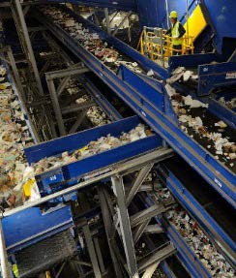
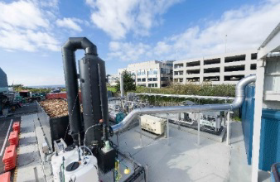
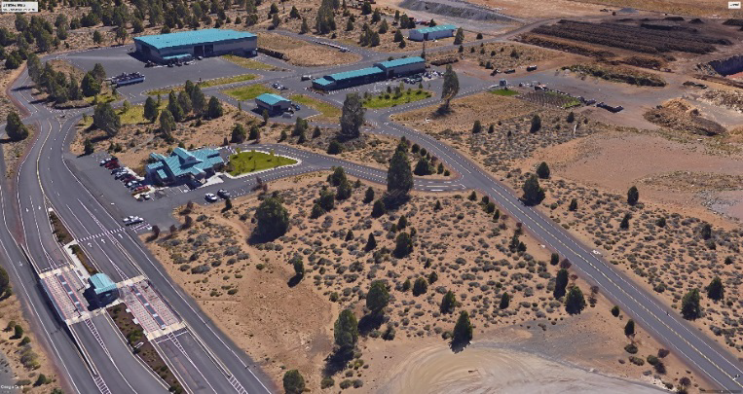






Slide 2
SWAC – Agenda 3/12/19
Introduction / Approval of Minutes
Summary of Public Meeting on Disposal Options
Chapter 7 – Draft Recommendations Discussion
Chapter 8 – Review / Comments Draft Recommendations
Priorities and Implementation
Comments of SWMP Summary
Next Steps

Slide 3
Public Meeting on Disposal Options
Open House format
Attendance
Feedback to date
Responses from meeting
Feedback from instant poll

Slide 4
Chapter 7 – Landfill Disposal Options
Table 7-6: Evaluation of Disposal Options
Primary Factors | Transport Out of County | New In-County Landfill
1. Implementation Considerations | Regional landfills are permitted and have available capacity County transfer stations will need to be modified to accommodate long haul transportation | Siting a new landfill has proven to be both environmentally and politically difficult and unpredictable for communities
2. Sound Financial Principles | Proximity of several regional landfills provides competition that can result in lower fees Impacts to local economy as revenue and jobs are created in other jurisdictions | County and cities control rates Revenue and jobs stay in County
3. Cost Effectiveness | Estimated cost to transport and dispose varies $47-$60/Ton | Estimated costs $35 disposal + $ 7 transport $42/ton (Assumes landfill is 25 miles or less from Knott Transfer Station) Note: After initial debt is retired 2040, the operating cost will be reduced by about $4/ton

Slide 5
Chapter 7 – Landfill Disposal Options
4. Rate Stability | Disposal contracts can be written to provide certainty of cost Factors outside control of County could impact fees (Host fees, fuel prices, road mile taxes etc.) | Based on history of tip fees at Knott Landfill, disposal costs are predictable and stable
5. System Flexibility | Flexibility can be part of contract; may have impacts on tip fee If minimum waste supply is committed, there may be possible impacts to County or cities to implement alternatives | County controls waste and disposal system and can make changes as needed (Example if local jurisdictions implement new diversion programs) County retains ability to manage waste without contractual issues
6. Reliability | Disposal is reliable Transporting waste to regional landfills may encounter interruptions In general, regional landfills have good track record for environmental compliance | Transportation and disposal are reliable Transporting waste on certain roads may encounter short term interruptions County has control and can manage environmental risks County can control nature of waste is disposed in the landfill

Slide 6
Chapter 7 – Landfill Disposal Options
7. Environmental Considerations | Disposing of waste in a regional landfill has the same impact as disposing waste In-County | Disposing of waste in an In- County landfill has the same impact as disposing waste at a regional landfill.
7.1 Impact from Landfilling: Greenhouse gas (GHG) emissions
7.2 Impact from Transportation: Waste Disposed 2030 – 216,000 tons/year 6,800–7,000 trips/year 2040 – 250,000 tons/year 7,800–9,000 trips/year | In 2030, 2–2.1 million truck miles and emissions along local roads and highways 97 and 197 In 2040, 2.3–2.7 million truck miles and emissions along highways 97 and 197 | In 2030, 340,000-350,000 truck miles and emissions along local roads and highways In 2040, 390,000-450,000 truck miles and emissions along local roads and highways
7.3 Impact on Land | Existing regional landfills are permitted and will continue to fill designated sites with or without Deschutes County waste | County will need to disturb 400-500 acres* County may adopt mitigating measures as necessary *Note: Existing quarry sites might provide opportunity to restore disturbed land

Slide 7
Chapter 7 – Landfill Disposal
Recommendations:
7.1 Recommendation – The County should site and permit a new in-County landfill to be operational when the Knott Landfill closes. The landfill should be
capable to handle all waste streams generated in the County.
Rational – The SWMP has identified and recommends several actions for County and
cities to take to reduce the amount of waste to be disposed in a future landfill. It also
recognizes that alternative technologies are continuing to develop that may at some
point prove to be feasible for extracting additional resources from the waste stream
and creating some form of renewable energy. Progress on these technologies can be
monitored. However, the best approach for managing and disposing waste
that cannot be recycled or diverted is to continue to operate an in-County landfill. It
provides flexibility and maximizes control for managing the County’s waste streams,
avoids impacts resulting from transporting waste long distances over highways and will be cost effective in the long run.

Slide 8
Chapter 7 – Landfill Disposal
Recommendations:
7.2 Recommendation – The County should begin a formal process to site and permit a new landfill by 2021.
Rational – The timeframe to conduct a process to select a preferred site may take from three to five years. Once the site is permitted, final engineering, obtaining construction permits and building the initial landfill cells is expected to require an additional three years. Using these assumptions, the site may be available in approximately eight years.

Slide 9
Chapter 8 – Administration and Financial Management
Chapter 8 – Purpose:
Review Current Administration / Financial Resources
Examine Needs to maintain and execute to Recommendations of the SWMP
Evaluate Options to Make Necessary Changes
Make Recommendations to Modify / Enhance System

Slide 10
Chapter 8 – Administration and Financial Management
Existing Solid Waste System Management
County – Department of Solid Waste (DSW):
  Owns / Operates Transfer Stations and Knott Landfill
System Structure:
  County Operates Facilities Contract Services
  County / Cities Interlocal Agreements
  County / Cities Franchise Collection Services

Slide 11
Chapter 8 – Administration and Financial Management
Findings:
County provides resources to operate and manage facilities that are compliant with regulations
Organization is in place to carry-out services
County / Cities / Franchise collection companies offer programs and
services that meet state WR/R standards
Participants has established coordinated promotion / education
w/ Environmental Center

Slide 12
Chapter 8 – Administration and Financial Management
Findings:
Current Management system operates effectively
    County / Cities / Franchise collection – deliver cost effective services
DSW has developed transfer system to provide convenient services
DSW has operated Knott Landfill in full compliance and financially sound
Effectively Use Internal Resources in Conjunction with Private Contractors
DSW has managed as Solid Waste Enterprise > 25 Years

Slide 13
Chapter 8 – Administration and Financial Management
Needs and Opportunities:
SWMP provides roadmap for enhancing services, making capital investments in infrastructure and addressing long term disposal of waste
    Changes to collection programs / services
        Expand residential food waste collection
        Development multi-family programs
        Expand recycling for businesses – food waste / recyclables
        Establish uniform / standardization for programs and services
        Develop Alternative for construction / demolition (C/D) waste
    Changes / Improvements for facilities
        Evaluate options / upgrade compost facilities
        Upgrade transfer stations – capacity / efficiencies / future disposal system
        Develop facilities for managing C/D waste
        Implement new disposal system

Slide 14
Chapter 8 – Administration and Financial Management
Needs and Opportunities:
As new collection programs are developed – facilities must be provided to manage materials and waste cost effectively
    County / cities need to work with franchise collection companies to evaluate and implement new programs; considering policies; establish rates and expand promotion / education
    Process needs to engage special interest and affected parties
    Solid Waste System Infrastructure requirements estimated to be between $20M and $30M – County needs to develop financial plan to implement facility improvements

Slide 15
Chapter 8 – Administration and Financial Management
Alternatives – Administration / Management
Maintain Existing Management Structure w/ Enhancement
  Establish Steering Committee
  Appoint Special task forces
  Establish SWAC – oversee implementation of SWMP
  Update Interlocal agreements

Slide 16
Chapter 8 – Administration and Financial Management
Financial and Funding
County to Evaluate Resources Needed to Support Implementation
Maintain County Enterprise System
  Uses County bonding authority – low cost for financing capital
  Establish reserves to maintain rate stability
  Rate setting / financial system is transparent
Finance w/ Bonds
Use Rates to Finance Improvements (Pay–Go)

Slide 17
Chapter 8 – Administration and Financial Management
Recommendations:
8.1 Recommendation – Given the need to implement the necessary changes to the solid waste management system over the next 10 years, the County should meet with cities to reaffirm commitments and update, as necessary, the interlocal agreements. The agreements should also address the cities participation in the process for implementing the recommendations adopted in the SWMP.
Rational – The current interlocal agreements recognize the commitment to support and rely on the County to own and operate solid waste facilities to dispose of waste generated in their jurisdictions. As the County endeavors to move forward with recommendations to the solid waste management system and to site a new in-County landfill, having the support and commitment to this arrangement is necessary. Also, in considering the agreements, cities should determine what role they wish to have in shaping the future solid waste management system.

Slide 18
Chapter 8 – Administration and Financial Management
Recommendations:
8.2 Recommendation – The County should establish a formal process that provides for continued involvement of cities, other stakeholders, businesses and the general public in implementing the recommendations of the SWMP. This process may include establishing an ongoing advisory group and /or assigning task force committees to oversee development and implementation of specific programs.
Rational – Whereas, the SWMP provides a road map and direction for shaping the future services of the solid waste management system, there are still many details to be determined. These changes will impact collection programs and services that are
directed by the County and each city. Also, as changes to these services are made the County, working with the private sector, must make improvements to system infrastructure to ensure facilities can handle materials and waste streams most efficiently. Having the continued involvement of the key stakeholders and others will only enhance the ability to oversee the successful implementation of the SWMP.

Slide 19
Chapter 8 – Administration and Financial Management
Recommendations:
8.3 Recommendation – The County should consider the current DSW
organization and determine the resources that are needed to carry out implementation of the recommendations adopted in the SWMP. This will require
perhaps some additional staff as well as financial resources.
Rational – DSW currently operates with a staff of 24 FTE positions that operate
four transfer stations and Knott Landfill. This is a fairly lean, but efficient
organization, that must continue to maintain the current level of services while
taking on additional responsibilities to work with cities and service providers to make
changes to implement new programs, enhance facility operations and make capital
improvements to existing facilities. The ability of DSW staff to take on new
responsibilities should be evaluated to determine what changes might be made to
execute the recommendations adopted in the SWMP.

Slide 20
Chapter 8 – Administration and Financial Management
Recommendations:
8.4 Recommendation – DSW should prepare a financial study of current
rates to determine the impacts of implementing the improvements identified in the SWMP and develop a plan for maintaining a stable financial strategy.
Rational – Operating as an enterprise fund, DSW has managed the rates and the financial resources needed to provide services to all constituents in a fair and
equitable manner. DSW has also established dedicated reserve funds that are used to levelize and minimize the impacts to rates, and for making scheduled capital
improvements for operating the landfill and providing disposal capacity. The SWMP identified improvements to transfer stations and compost facilities and the siting and construction of a new in-County landfill. These improvements could cost between $20 to $30 million over the next 10 years. Forecasting and scheduling these new investments and evaluating the options for how these improvements can be financed will result in developing a strategy that results in the most cost effective approach.

Slide 21
Implementation – SWMP Priorities
1. Establish on-going process to engage stakeholders to develop waste reduction and recycling
  Develop standardized WR/R programs
  Develop strategies for expanding multi-family and business recycling programs
2. Complete waste characterization study
3. Complete facility plan and design for retrofitting Negus TS
4. Review financial needs and update CIP
5. Develop landfill siting process

Slide 22
Recommendations and Implementation Schedule

Slide 23
Recommendations and Implementation Schedule

Slide 24
Recommendations and Implementation Schedule

Slide 25
Recommendations and Implementation Schedule

Slide 26
Recommendation and Implementation Schedule

Slide 27
Recommendations and Implementation Schedule

Slide 28
Upcoming Schedule
April 23rd SWAC Meeting
- Final Draft SWMP
- Executive Summary & Implementation Schedule
May – Final SWMP to Board of Commissioners

