Slide 1


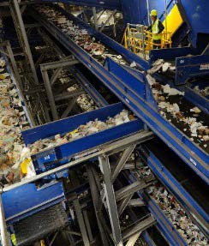
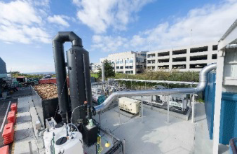
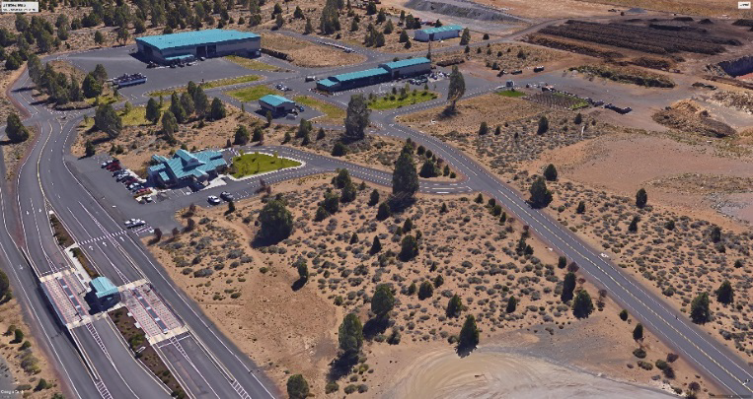
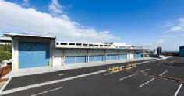





Slide 2
SWAC – Agenda 4/23/19
1. Introduction – Timm Schimke 5
Approval of Minutes
2. Review of Implementation Schedule
Summary - SWMP
3. Comments on DRAFT SWMP by SWAC
Invitation to the SWAC members to make any final comments
4. Next Steps

Slide 3
Summary of SWMP 2019
What does the SWMP Say?
Findings
The Current Solid Waste Management System works well and there are no major or immediate deficiencies in the current system
  Cities and County work cooperatively and effectively to deliver services
  The County provides leadership and DSW working with franchised collection companies
  to provide and maintain the necessary infrastructure
  System is in compliance with standards and regulatory requirements
  Rates charged for collection services are comparable or lower for the level of services
  The disposal rate of $55 per ton which included operations of transfer station is perhaps one of the lowest in the state

Slide 4
Summary of SWMP 2019
What does the SWMP Say?
Primary Needs and Challenges
  Expansion of Waste Reduction, Reuse and Recycling (WR/R) to achieve higher recovery rate and reduce waste disposed
      Distance to markets and uncertainty in markets
      Expanding multifamily program to capture these consumers
      Impacts of tourism on waste stream
  2. Growth
      Deschutes County has and is expected to grow faster than rest of the State
      Transfer Stations and composting facilities will need to be upgraded/expanded
  3. Siting a new landfill to replace Knott Landfill

Slide 5
Summary of SWMP 2019
What does the SWMP Say?
SWMP 2019 provides a comprehensive examination of the system and alternatives
Identifies a set of actions for expanding services considering a logical and timely approach to increase the recovery rate/reduce waste disposed
      Expand basic WR/R to increase participation and address multifamily recycling opportunities
      Target expansion of food waste/organics collection & processing – can be developed locally independent of out of region markets
      Develop alternatives for managing construction/demolition waste

Slide 6
Summary of SWMP 2019
What does the SWMP Say?
Identifies the need for capital improvements for infrastructure to support new services
and meet challenges of growth
      Transfer Stations will need to be upgraded/expanded
      Organics processing/composting facilities will need be upgraded
4. Considers potential alternative technologies that might be feasible in the future
Establishes need for a new in-County landfill to be available when Knott Landfill Closes (expected in 10 years)
6. Provides recommendations and set of actions to be implemented over the next 10 years.

Slide 7
SWMP Implementation Schedule 2019

Slide 8
SWMP Implementation Schedule 2019

Slide 9
SWMP Implementation Schedule 2019

Slide 10
SWMP Implementation Schedule 2019

Slide 11
SWMP Implementation Schedule 2019

Slide 12
Final Draft SWMP 2019
SWMP provides roadmap for enhancing services, making capital investments in infrastructure and addressing long term disposal of waste
    Changes to collection programs/services
        Expand residential food waste collection
        Development multifamily programs
        Expand recycling for businesses for food waste/recyclables
        Establish uniform/standardization of programs and services
        Develop Alternative for construction/demolition (C/D) waste
    Changes/Improvements for facilities
        Evaluate options/upgrade compost facilities
        Upgrade transfer stations–capacity/efficiencies/future disposal system
        Develop facilities for managing C/D waste
        Implement new disposal system

Slide 13
Final Draft SWMP 2019
Comments By SWAC

Slide 14
Next Steps
SWAC Comments
Send Draft SWMP 2019 to Board
Conduct Additional Survey
Present Final SWMP to Board of Commissioners

